Slide 1
SciProp: Analysis & Obituary robert.bennett@rcn.com
Nov 2023
It isn’t what we do not know
That causes grief and woe,
As much as what we think we know
That turns out just not so.
Notes:
1- use email for comments/feedback historical approach

Slide 2
Scientific method
Record data
Form hypothesis
Design test……..? Scope in space?....in time?
Perform tests for proof
Accept/reject hypothesis ……? Philo=? Reasoning? Ideology?
raw data
Physics Bio, Chem …
theories & laws
Notes:
2- fallacies: Occam’s Razor? Sci is sole path to truth…..science vs tech
….some evidence, not all ….. Philo errors inductive => weak

Slide 3
Knowledge Domains
Theology
all religions
Philosophy
all –isms
Scientism
bio, chem…..
Physics
Notes:
3- aberrations: Physics only….upside down… sci analyzes ‘how does it work?’ ; theo integrates “what does it mean?’
Potential PS topics : Philo & Theo: Realism in Genesis Wolfgang :”Theistic evolution”
St Hildegard’s Cosmology in Genesis and Science distro Hild…notes

Slide 4
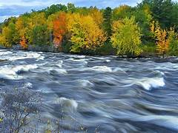
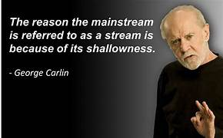
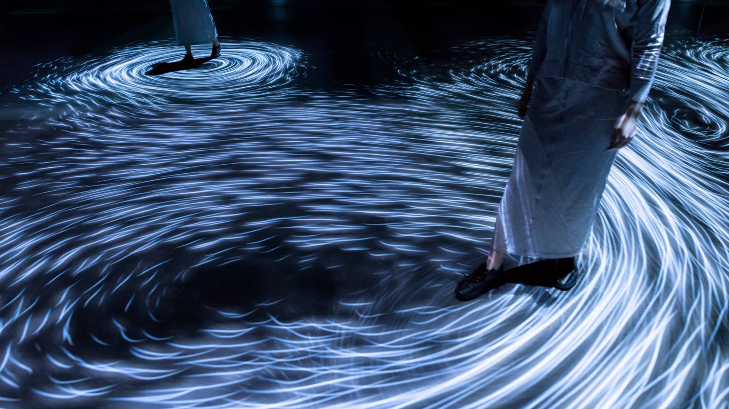
MainStream Analogy
Paradigm shift timing
1- Ignored
2- Mocked and ridiculed
3- Accepted by all as always true
Pauli:
All mainsteam opponents die
Notes:
57- MS: thought DS: obstacles … CW vs CCW… like repel…MS separates the 2 types
Many vortex = turbulence/chaos

Slide 5
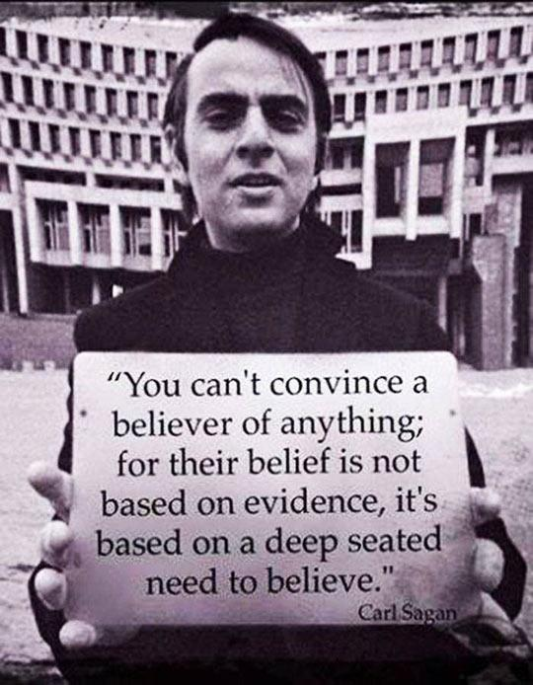

Slide 6

Dissident Motto

Slide 7
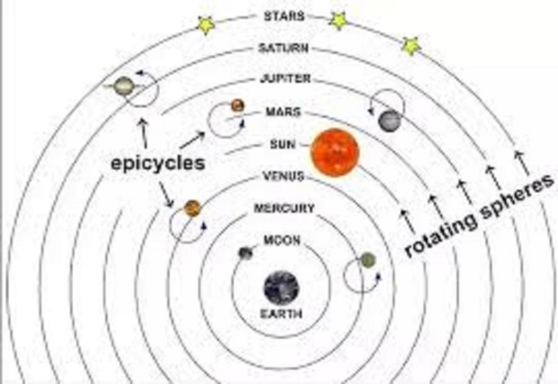
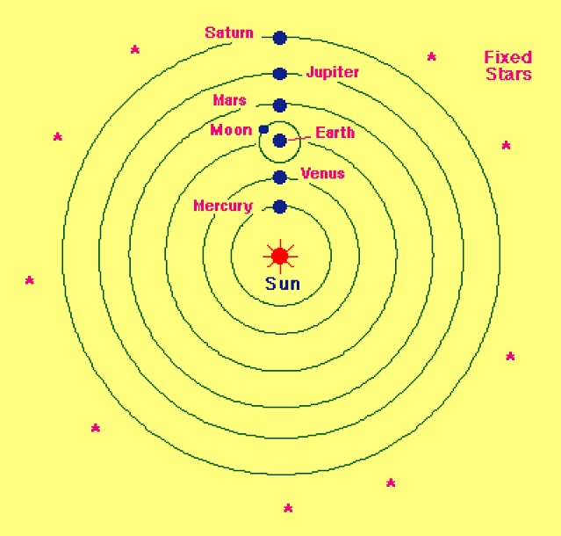
Ptolemy –GC 150 AD Copernicus – HC 1543
Notes:
4- Historical path….
Ptolemy one of a few GC models probs: Venus phases ,,,retrograde motion
HC: Moon satellite => hierarchy note fixed stars. Sun and stars immobile
First sci challenge of theo

Slide 8
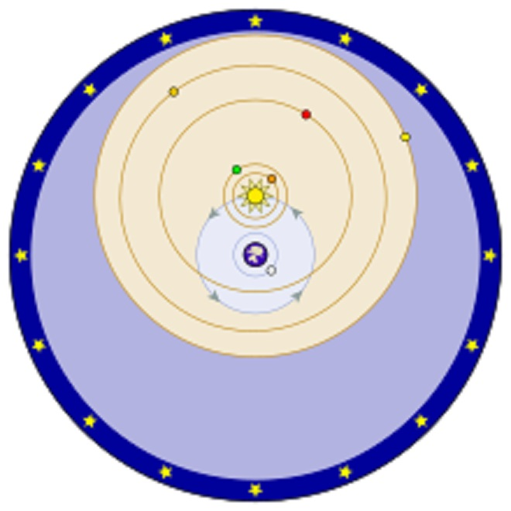
Tycho Brahe GC 1583
Earth – center
Sun & Moon
Planets stars ?
Moons
Validated by the Sci Method
Notes:
5 Tycho: hierarchy model same predictions as HC ignored by MS 40 yrs after HC
Sun orbits Earth?? Gravity in GC…..spinning bucket ….less dense aether = g!

Slide 9
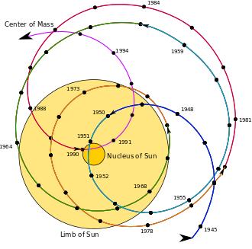
Solar system barycenter
JPL model

Slide 10
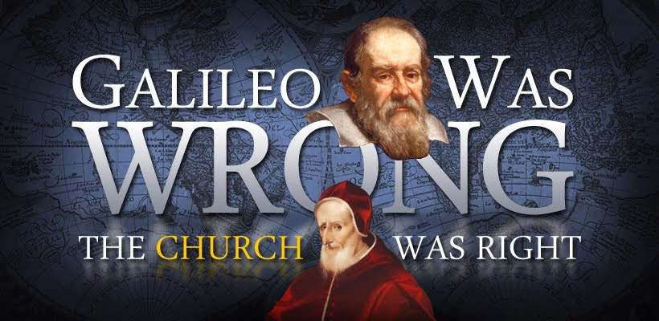
GWW
Bible belief is Geostatism, not Geocentrism!
Notes:
6- Ad link to copy in cloud Galileo cited as proof of sci over religion?!
Joshua’s long day Hezekiah shadow on temple steps.

Slide 11
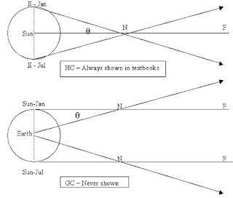
Stellar parallax 1832
Parallax :
position shift of 2 objects
relative to a 3rd.
reference line is S-N-F
Notes:
10- MS proof of HC: HC done in April HW: find the GC model ref ….. theta same for both
An example of kine…so relative measurement.

Slide 12
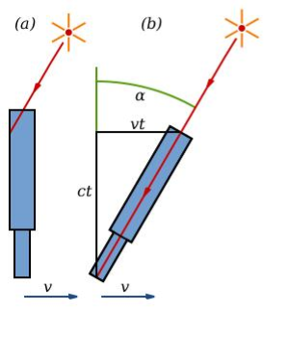
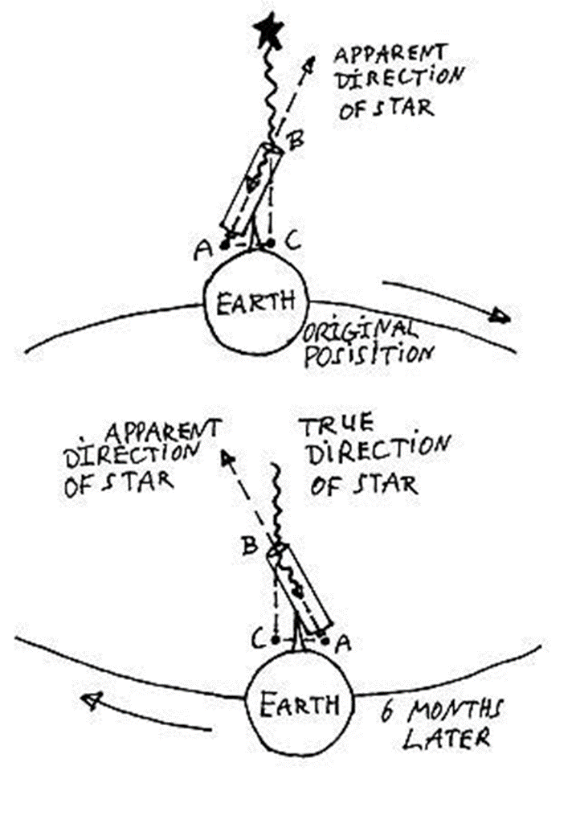
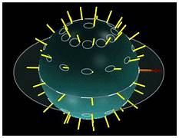
Stellar aberration 1727
Notes:
7- Bradley …Latitude dependence HC proof? Applies to all stars truth : Airy’s failure

Slide 13
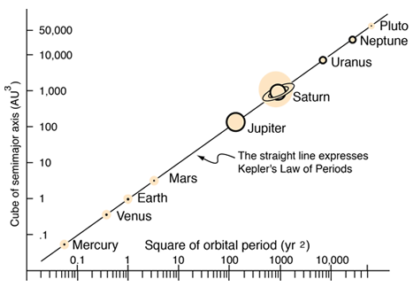
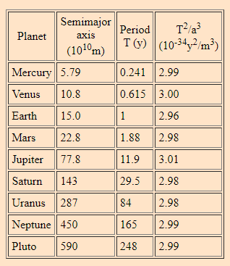
Kepler’s 3rd law 1609
Fg=GmM/R² =Fc = mRω² =mR4π²/T ²
=>(GM/4π²)T ² = R³

Slide 14
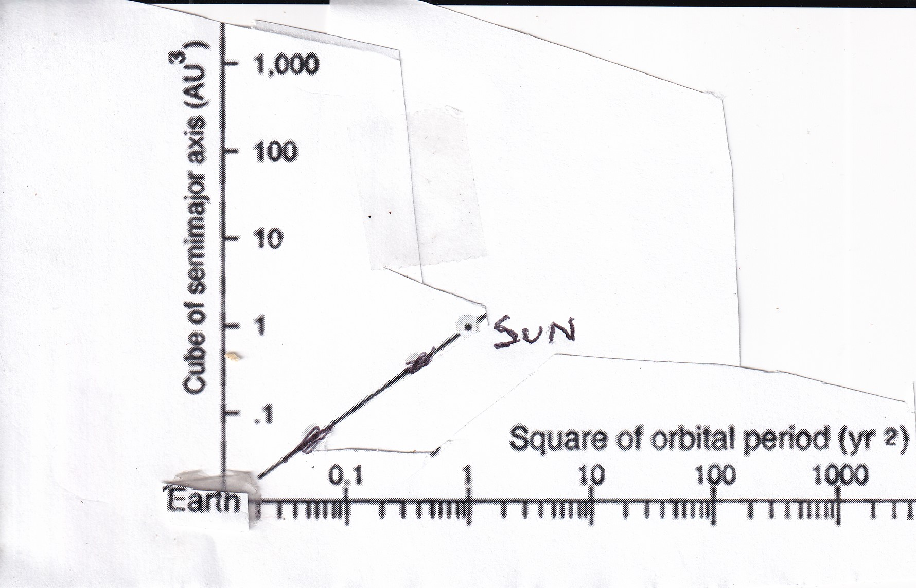
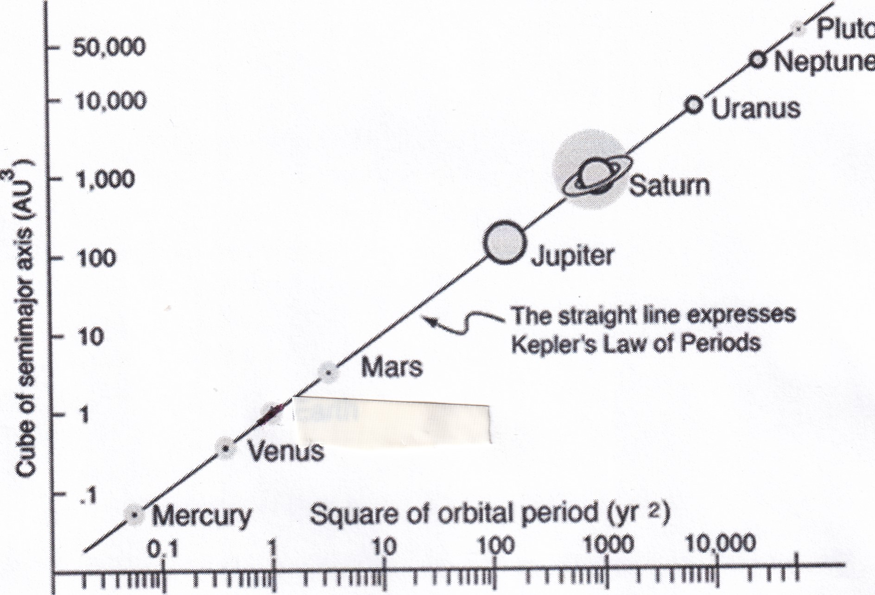
Kepler and Tycho Brahe

Slide 15
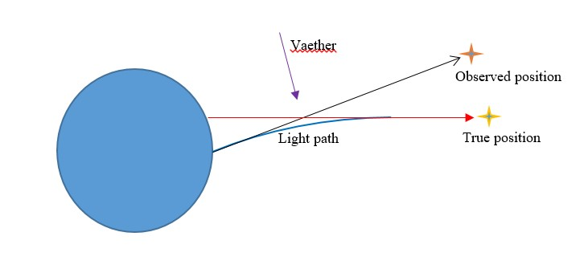
Airy’s failure …. Video slide
Airy's Failure speed =1, end at 3:30
Notes:
8- 2 Vea causes tilt 3 Vae causes tilt 4 water => <c 5 prediction 6 actual
Proof: aether wind exists & earth at rest simple yet ignored.

Slide 16
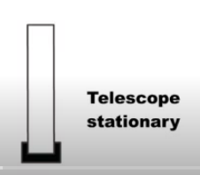
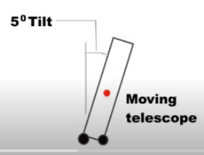
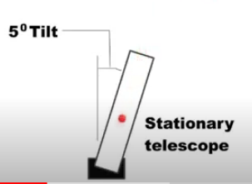
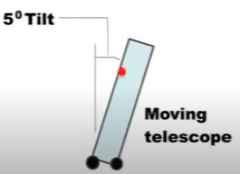
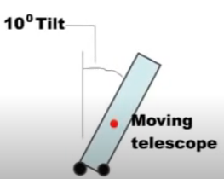
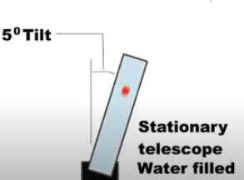
Airy’s Failure 1871
Aether V = 0
Aether V
OR
Aether V = 0
NO!
Aether V
Notes:
8- 2 Vea causes tilt 3 Vae causes tilt 4 water => <c 5 prediction 6 actual
Proof: aether wind exists & earth at rest simple yet ignored.

Slide 17
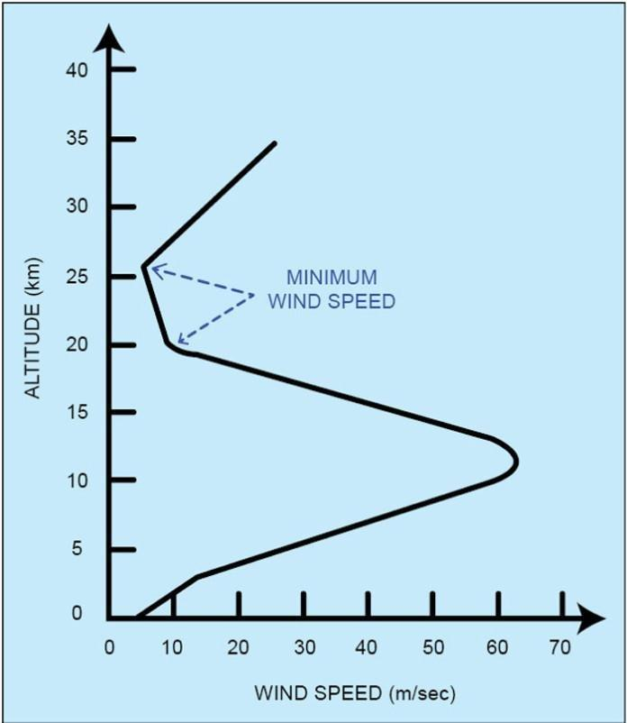
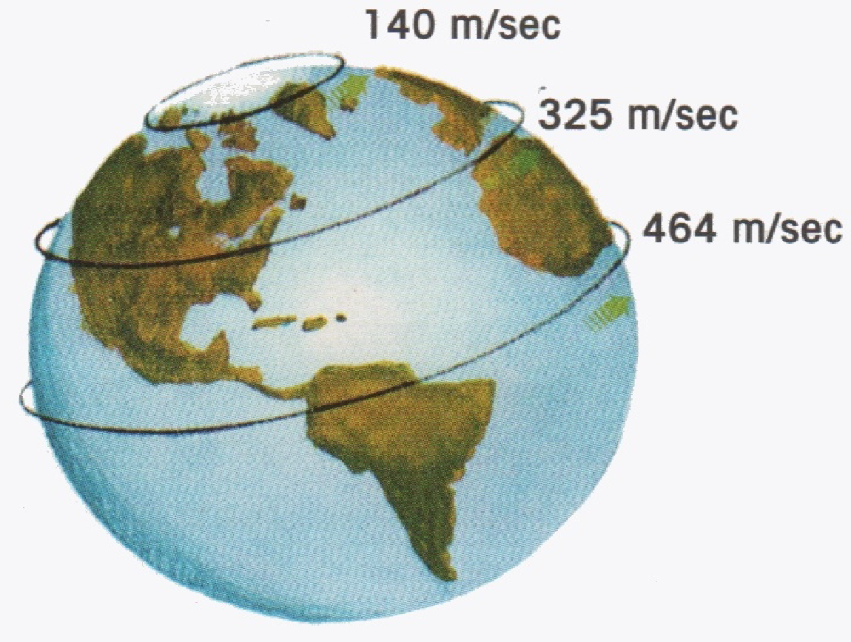
Air drag
MS model
Notes:
No aether

Slide 18
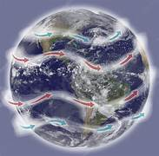
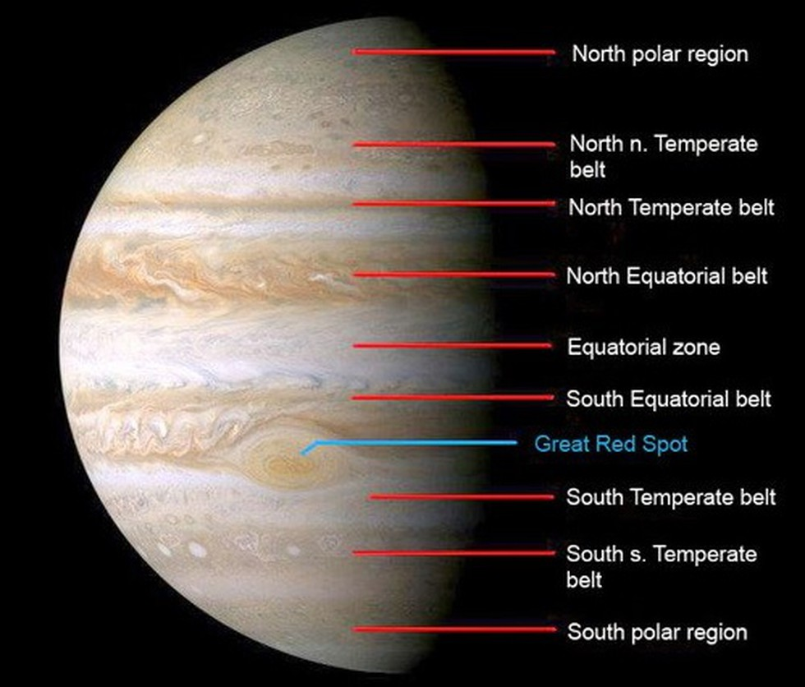
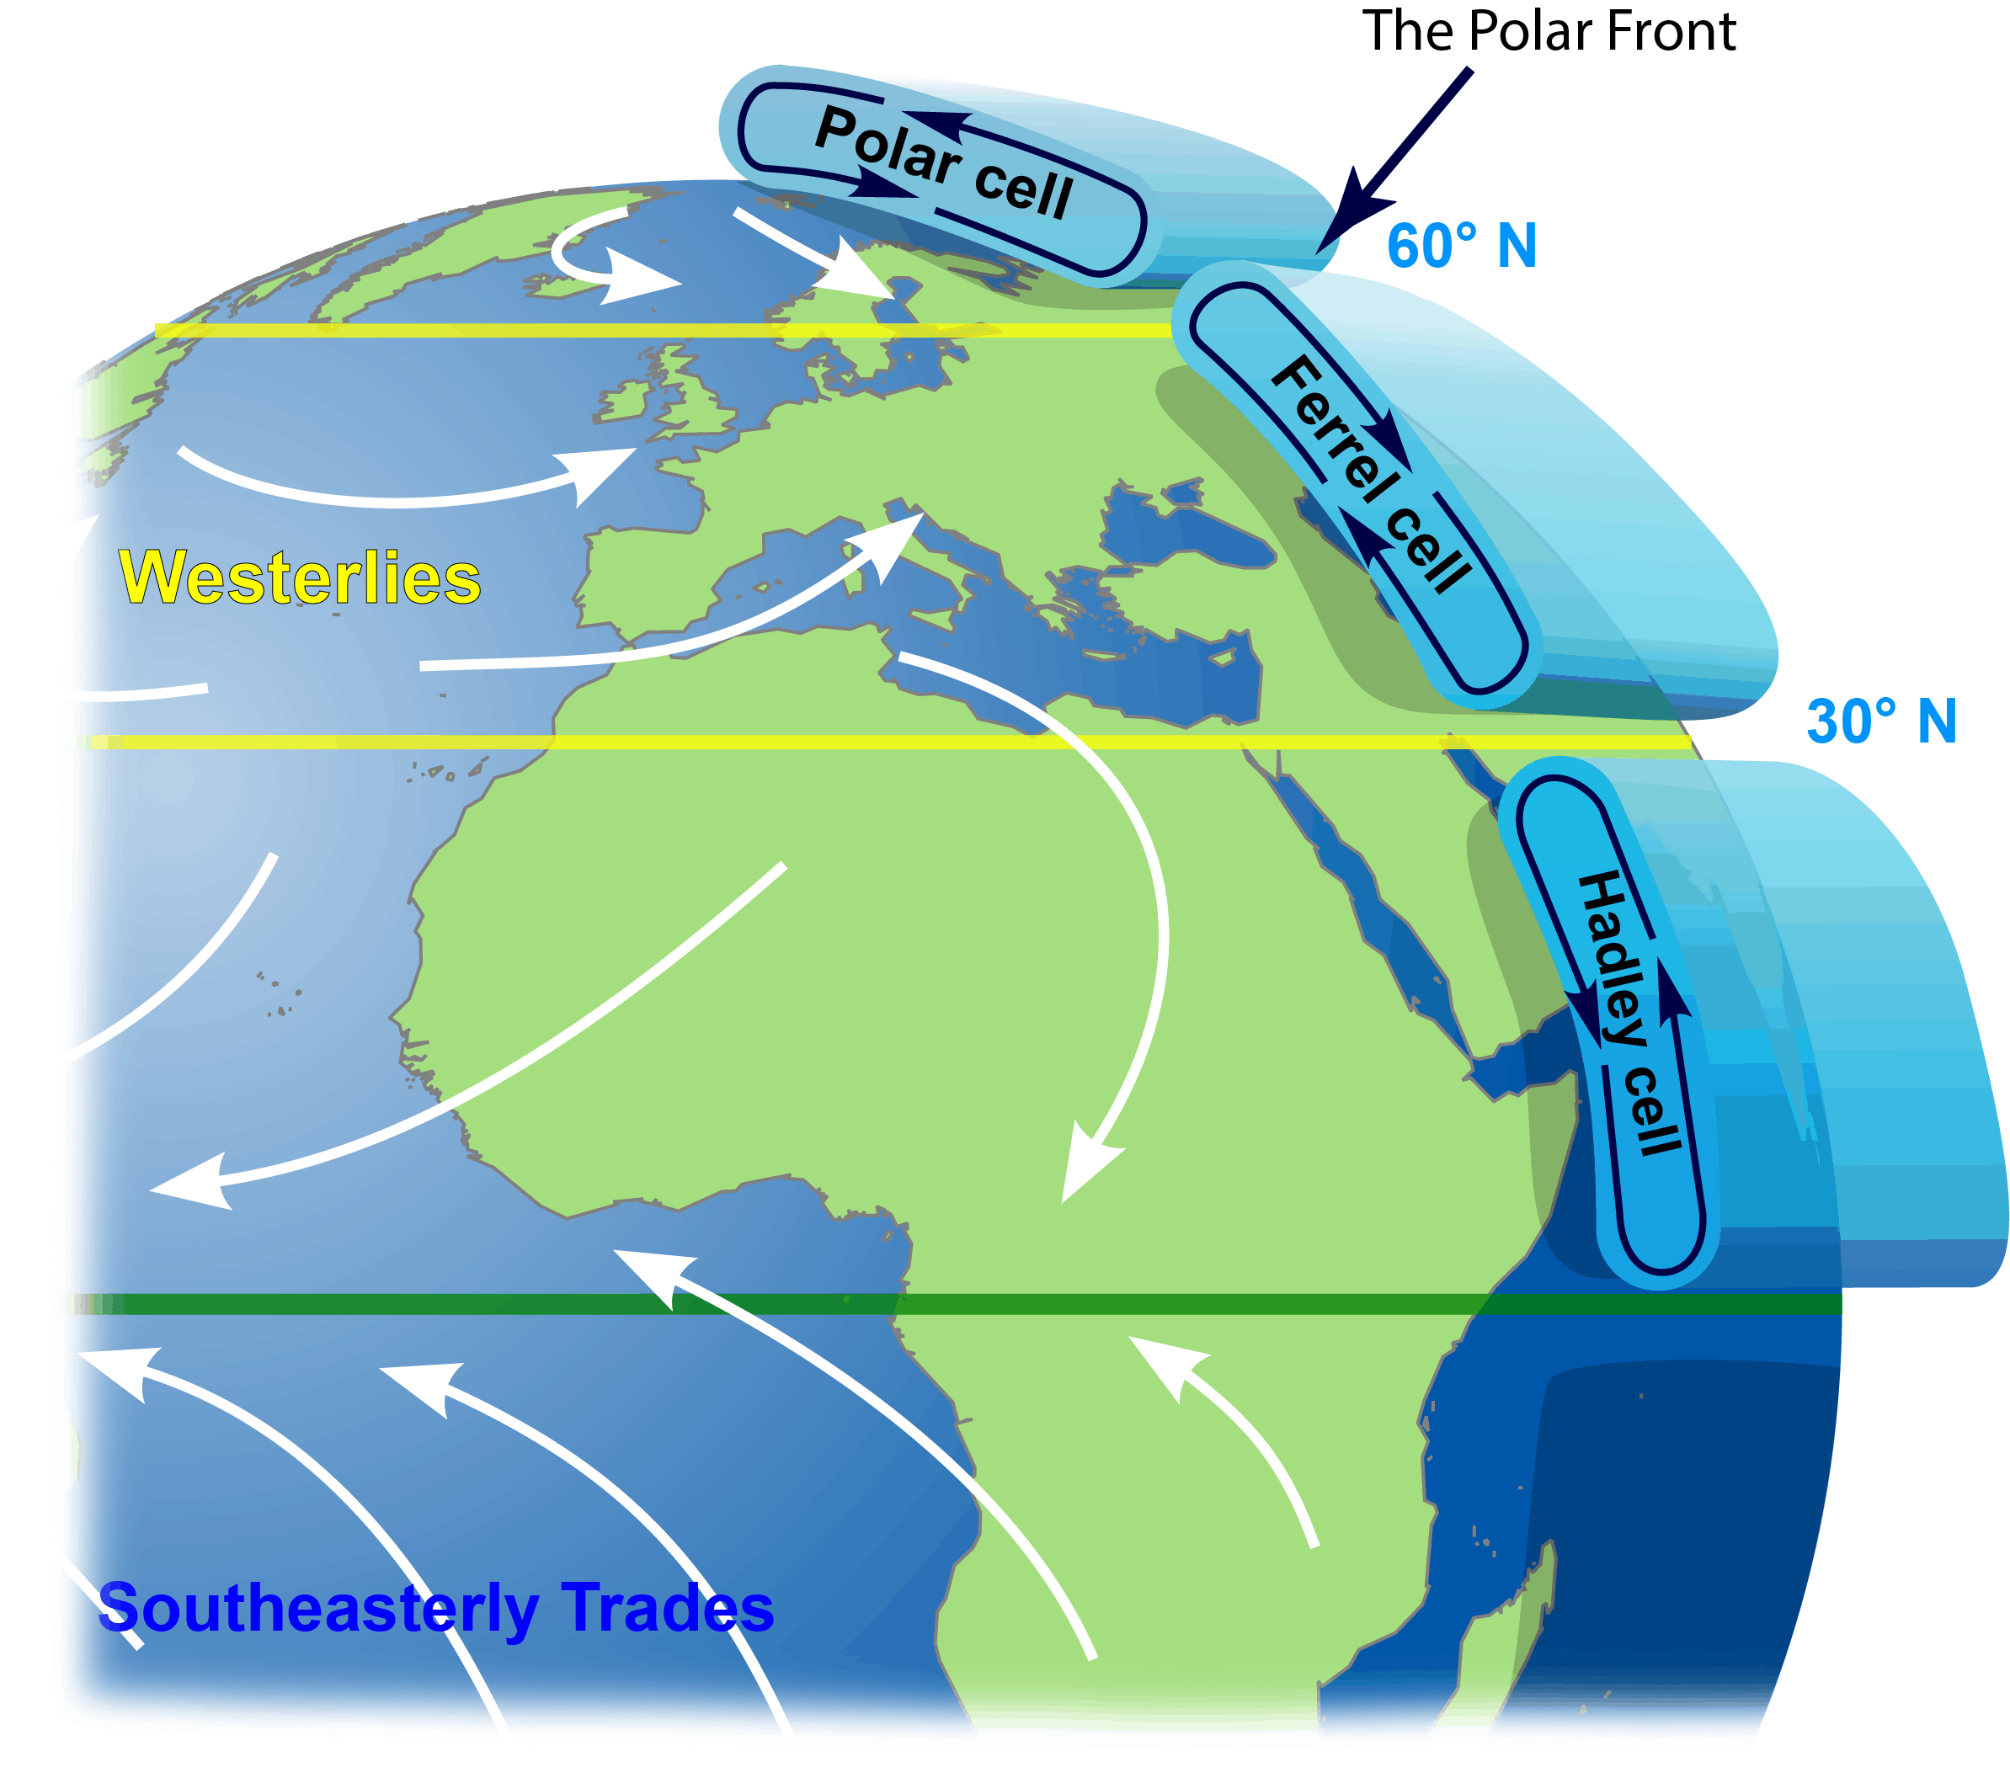
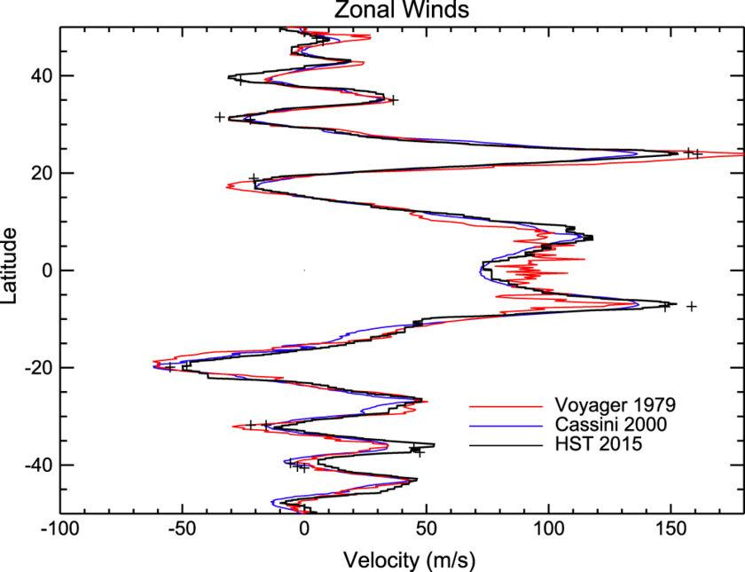
Jet Streams & Circulation Zones
Earth Jupiter
Notes:
Jets: solar powered? ….entropy. Stops at night? Faster than earth rotates! ….

Slide 19
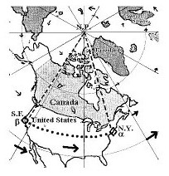
Eastbound aether wind

Slide 20
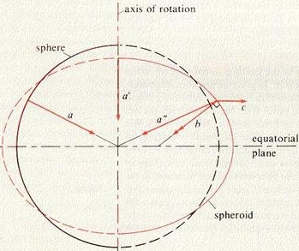
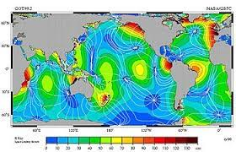
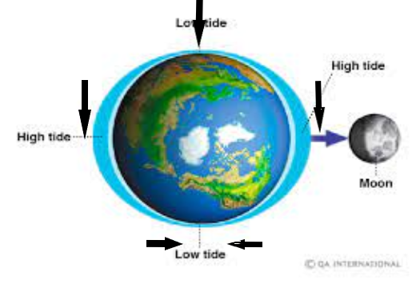
Tides

Slide 21
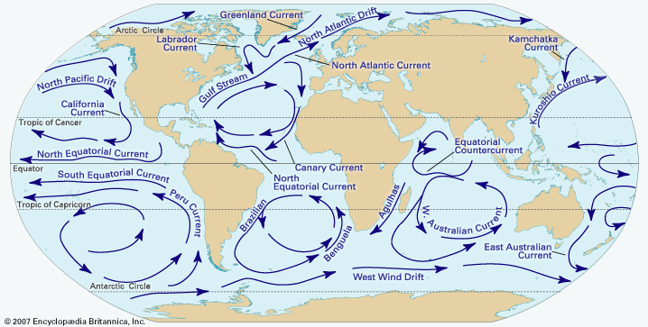
Ocean aether currents
Cause: temp? salinity?

Slide 22
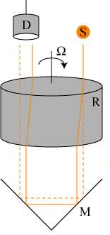
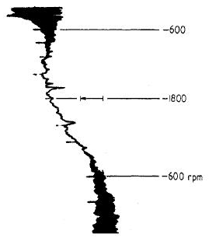
Jones Aether test 1971
Notes:
32- aether drag 1975

Slide 23
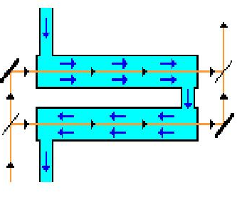
Fresnel drag test 1851
Fresnel’s Law:
SoL = c/n + v(1-1/n²)
In vacuum: SoL = c+v
In air: SoL ~ c+v
In water: SoL = 0.75c+0.44v
ALFA model
Notes:
33- water drags aether

Slide 24
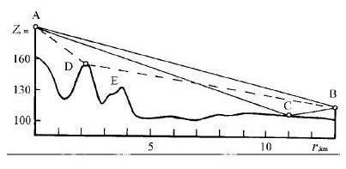
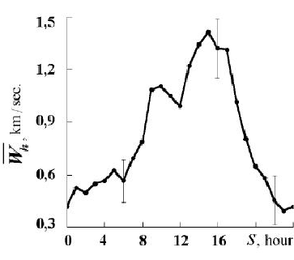
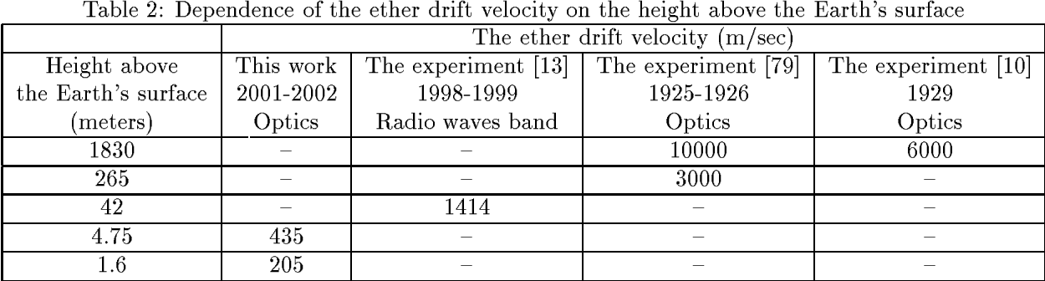
Galaev aether test 2002
Notes:
35- radio waves air and humidity cause graph errors varies with height(gravity) and time.
gravity is static aether, aether winds have stellar sources.

Slide 25
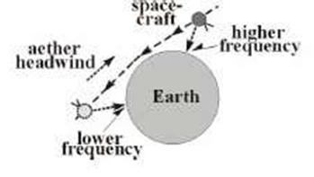
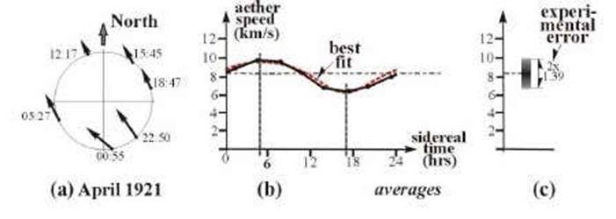
Flyby anomaly with aether headwind, both Doppler frequencies are higher than expected.

Slide 26
Summary of aether tests type speed in km/s direction
Miller MMX 374 +- 63 (5.2h, –67^{O})
Marinov rotating mirrors 350
Torr & coax cable 417 +- 40 (5.2h, −65 ^{O})
Kohlen
Cahill flyby 400 +- 20 (5.5h, –70 ^{O})
NASA flyby 420 +- 30 (5.2h, –70 ^{O})
CMB dipole satellite 368 (6.4h, -48)

Slide 27
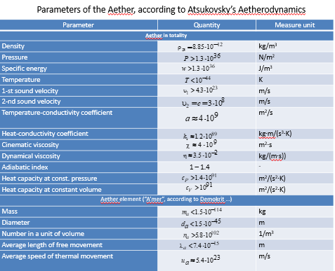
Atsukovsky aether properties
D:air 1.2
P: atm 10⁵ N/m³
SE:H bomb = 10¹⁵ j aether = 10¹⁶ j in 1m³
2SVel:star R = 10¹² Lyr
CV/DV:hard to push; easy to spin
M: electron = 10⁻³⁰
D: “ = 10⁻¹⁰

Slide 28
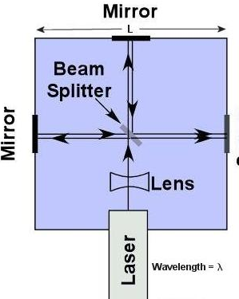
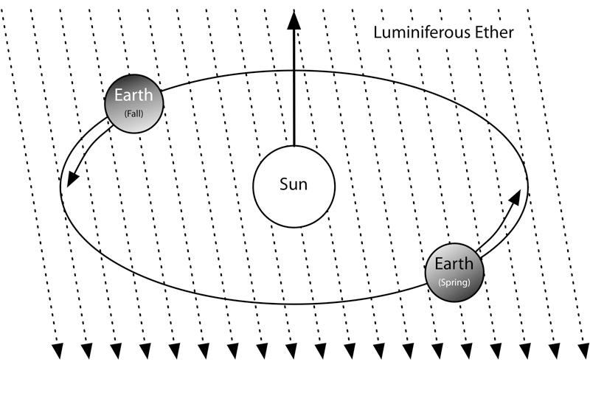
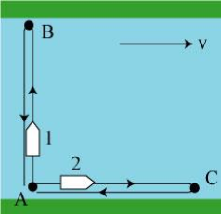
MMX 1886
Notes:
18- aether test… Ʇ beams

Slide 29
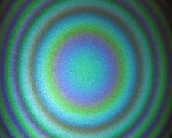
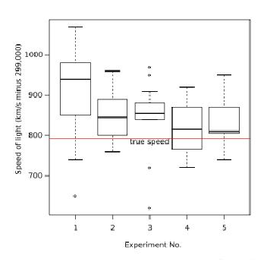
MMX
For tests of isotropy/constant SoL,
Vacuum Interferometers invalid
Demjanov
As n = SoL/c => 1, light wave amplitude => 0
Notes:
19- null! 30 km/s expected… MS crisis : Earth speed = zero! ALFA: w 5 km/s wave. Miller et al..

Slide 30
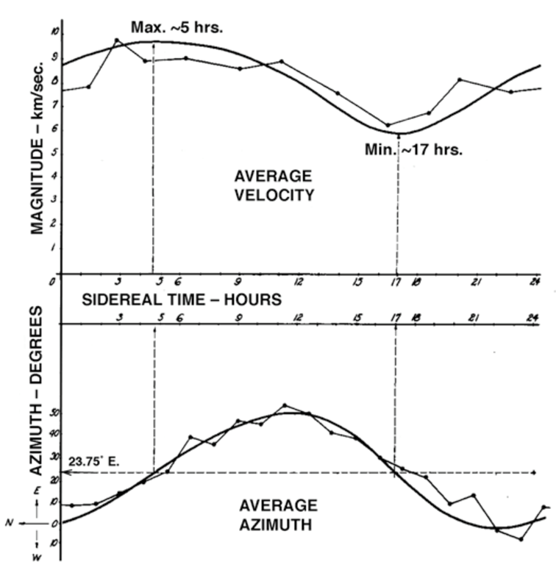
Miller Mt Wilson

Slide 31


Demjanov MMX test 2010 n=1 => zero light wave amplitude => SoL = c n>1 => SoL = c + V => V = Vae ~ 140 to 480 m/sec Amp = 0 at n=1 & n= √2 fringe shift change = 12% : winter to summer

Slide 32


Michelson-Gale 1925
Notes:
36- MS: proof earth rotates, like FP…. Sagnac type does prove SoL <> c

Slide 33



Foucault pendulum 1851
Rotation of Earth….
FP must sense the stars (Mach’s principle) or aether?
Bible and Hildegard support
Notes:
34-

Slide 34
Einstein’s 1905 Special Relativity paper
What’s right: 2 sections: Kinematics & Dynamics..but not applied correctly.
Proper time ? t = t₀/√(1-v²/c²) but v=> v_{obj} ; c => c +v_{a}
Length contraction? Not observed… rigid rod conflict!
Faraday Law reversal Absolute Reference Frame(Lab), not relative motion
MMX: 1) HC …Earth in solar orbit XXX 2) no Aether XXX
Postulate 1: Laws of Dynamics are valid in inertial frames of reference.
Postulate 2: Speed of Light(SoL) is always c in vacuum.
Disproof: Ruyong Wang(2005) ALFA: Absolute Lab Frame + Fluid Aether
Also: Sagnac(1913)
No references
Notes:
20-

Slide 35
False premises in the 1905 paper
The MMX found ‘null’ speed of Earth through aether. XXX
Relativity applied to dynamics. XXX
The aether did not exist. XXX
The Earth orbits the Sun. XXX
Notes:
21-

Slide 36




Three Tests of General Relativity

Slide 37

Eddington star plate

Slide 38

Time dilation…light clock
SR: L=cto , x=vt, hyp=ct
(cto)² + (vt)² = (ct)²
=> t= to/√(1-v²/c²) velocity Δ: c² + v²= c² X
ALFA/aether
Vmir = Vae !
(cto)² + (vt)² = (c²+v²)t²
=> t = to ! velocity Δ: c² + v²= c²+ v² √

Slide 39




Sagnac test 1913
=> SoL = c +|- v
“The interferometer measures, according to the expression zλV0/4, the relative circular motion of the luminiferous ether within the closed optical path”
Notes:
39- 1913 refutes SR used in tech, but not understood…nav: vector eqn

Slide 40

Dufour & Prunier 1942
SoL = c+v ind. of light source & interferometer radial motion…no effect
SR fringe shift 10 times less than data
(v²/c² versus v/c)
In a system moving as a whole relative to the ether, the propagation time between any two points of the system should change in a way similar to a stationary system subjected to an ether wind, the relative speed of which at each point of the system will be the same and directly opposite to the speed of any point and would contain light waves in a manner similar to atmospheric wind carrying sound waves. …..
The observed interference effect is very much the effect of optical rotation due to the motion of the system relative to the ether, and directly shows the existence of the ether, a necessary condition for the luminiferous [ether] waves proposed by Huygens and Fresnel.

Slide 41




Wang Linear Sagnac Test 2005

Slide 42


Wang results if v = 0,SoL = c in all frames; for v > 0 SoL= c + v ====🡺
To do: Map Earth aether with
Wang/Sagnac test?
Then ISS or Moon?
Galileo’s ship
 | Kine-matic | Special Relativity | Dynamics (Galilean)
Lab | c+v | c post 2 X | c+v
Con | c+v | c post 2 X | c post 1 X

Slide 43


Professing themselves to be wise, they became fools.. Rom 1:22

Slide 44
End of Part I

Slide 45


Hildegard Cosmology 12th century
5 Spheres: Fire, Aether, Water, Air, Earth

Slide 46



Hildegard aether winds
Psalm 147:4 ‘He named the stars’
Psalm 33:6
‘He breathed, and stars were born.’
Daniel 7:9 the Ancient of Days took his seat….
…A river of fire was flowing, coming out from before him.
Notes:
Tycho model……like angelic shooting gallery. Animal names …control Sun & Moon, planets, moons , etc

Slide 47


Geostat Sat & Hildegard
Geostationary Satellite(GeoSat)
HC/Newton
rot(E) = rot(Sa
GC/Hild: rot(E) = 0
rot(stars)= rot(rot(sat) = rot(Sun) + rot(Moon)
Notes:
theo, bio, music, cosmology… HC is Newtonian in GC – spinor is aether wind

Slide 48

Aether Gravity Model
1) Universal gravity … P_{cosmos} = constant cosmic pressure
2) Impact of spinning atomic particles Each has Acf = v²/r
3)Bernoulli’s eqn: P + ρv²/2 =const. when v↑ , P↓
4) Pressure drops inside each mass P <Pcosmos
5) surface gravity: sum of all atoms Gravity ~ Pcosmos –Σ(Pi)
Particle motion causes gravity!
Why Fg~1/R²? need Quantum Aether Theory!

Slide 49



Newton’s Bucket 1687
Lab frame
Result
Prediction
F_{c} = mv²/r
V > 0
Fc > 0 OK
Bucket frame
V = 0
Fc = 0 XX
Notes:
11- Imp: water used as force detector.. => delay..B frame: when Vwater = Vbucket…MS resp ?
Extend to all possible buckets…m,r,D…. => ECEF inertial frame

Slide 50
Fictitious Forces!
Lab frame
Result
Prediction
F_{c}=mv²/r
V > 0
Fc > 0 OK
Bucket frame
Fc = 0 XX
Not inertial,
So add
F_{c}=mv²/r !!
V = 0
Notes:
12- MS solution: find f in lab, then insert in bucket frame……. my reaction to 1st hearing.

Slide 51


Mach’s principle 1883
Mainstream:
“physical law relating motion of distant stars to local inertial frame.”
“local laws determined by the large-scale structure of the universe.”
Earth?….Yes stars? …..No
Newton: Absolute ref frame!....but where?
“
Notes:
13- So…In star frame: forces due to earth!

Slide 52

Bennett’s Hiker 2018
Notes:
14- Reverse fake force,,,,,force predicted, but none felt … extends NB to linear forces

Slide 53


Kinematics motion measurement variables t, x, v, a……….math
Circles => a_{c} =v²/r Free fall => a = g, d = at²/2+v_{o}t +d₀…..
Pendulum: T = 2π√(L/g)
Relative motion valid: V_{ab} = -V_{ba} …observer/ref frame independence
Induction: specific to general quantity of motion
Notes:
15- motion abstraction: more math than physics. Circle could be galaxy …or electron….. Not exp vs theo physics.

Slide 54
Dynamics Intro
Motion prediction variables + (m, F, I, Q,etc.)…..physics
Relative motion invalid
Observer/ref frame dependence = Lab/Earth frame
Proof of Absolute Lab Frame: Bucket/Hiker Faraday
Deduction: general to specific quality of motion
Dynamics asserts geo-statism, removing relativity, special and general, from rational consideration as a predictive theory.
Notes:
16- note: gen. coordinates assumption is cause of false frame independence …...

Slide 55



Dynamics Theory
q_{k} = generalized coordinates
Kinematics: actual motion measurement
Dynamics : future motion prediction

Slide 56


Kine vs Dyn

Slide 57

Covariance reference frames effect on physical laws eqn(r,t,v,a) =? eqn(r’,t’,v’,a’) coordinate system change(cartesian to polar) => weak covariance reference frame “ (earth to satellite ) => strong “ eg: F= ma =>? F’= ma’ same form => covariance
Lorentzian: Galilean: x’ = x –vt; t’ = t
=> forces v²/c² into measurements!
 | No Aether | Aether | Mainstream Einstein
Newton Mechanics | Galileo | Galileo | Lorentz
Maxwell Electromagnetism | Lorentz | Galileo | Lorentz

Slide 58

Faraday Induction…the Generator 1831
Faraday Exp speed 1; end at 2:25 meter stationary only EMF = qVc,m Ʇ B line 3 & 6 XXX

Slide 59

Faraday’s anomaly
EMF = qVc,m Ʇ B
Test SR Agree?
Disk spins => √ √ √
Magnet spins => NO √ X
Both spin => √ NO X
Use ALFA? Vc,m => Vc,Lab √
Result: SR X ALFA √
Notes:
17- Vd,m SR prediction….refutes relativity cause of EMF…same as mechanics! Generator! …. MS: relative motion of D and M

Slide 60
(Aether) Vector Potential
Vector : Size & Direction V V(x,y,z) → or V(r,θ,z) 🔄
∇V vector change …in shape/space
∇∙V divergence …radial change in V
∇xV curl .. change in rot/spin so …..∇∙(∇xV) = 0 ∇
Eg: Faraday’s law: ∇xE = ∂B/∂t
∇∙B = 0 so let B = ∇xA & ∇∙(∇xA) = 0
Use other Max laws => E = -∇φ - ∂A/∂t now 6 => 4! Maxlaws(E,B) => Maxlaws’(A, φ)

Slide 61



Aharonov-Bohm Test
B=0 but A>0 outside Emag
QM prediction
E-beams interference only for A
Classical E&M ~ QM
=> A is Aether field

Slide 62



GPS
Notes:
22- diag 1 SoL = c +- v …. diag 2: blue line SR d= ct ALFA or ECEF: d= (c +_ vsinθt

Slide 63
GPS ~1980
Clock Corrections
Satellite clocks use GPS time in the ECI reference frame
ECI = Earth Centered Inertial (Star frame)
Ground receiver clocks use UTC time in the ECEF reference frame
ECEF = Earth Centered Earth Fixed
ECI => Solar day => 1 year, 6 mos of day, then night
Lunar tides change every 6 weeks, not 12 hrs
NOT OBSERVED!
ECI is a fantasy frame! (of mathematicians posing as physicists)
Notes:
23- ECI: theme of movies: day = yr; tides every 2 months math > physics! …. Engineer solution

Slide 64
E = mc² ?
< 1905:
First to state? Lorentz/Poincare’ et al
E= (4/3)mc² only for EM mass
Others: E= kmc² k = 0.5 to 1
AE: 1) E includes kinetic energy
2) k =1
3) derived from SRT ….XXX SR is false
Agrees with aether models:
A + for big Al: 1922 Nobel prize for the Photoelectric Effect

Slide 65
Stellar Reference Frame ….SRF
No diagram possible: Where to place observer?
Not testable
Sun is star , but SRF is not the HC RefFrame
Inter stellar motion => which star is the SRF?...binaries
Inconsistent definition: In the Andromeda RF,
Earth => part of the stellar frame => Lab RF = SRF!

Slide 66

Noah’s Flood
Grand Canyon Evidence
Rapid layering
Sea life far above sea level
Trans-continental layers
No erosion since formation
Notes:
24- Steno geomodel…past key to future; uniformitarianism slow uniform sediments;
Age ~ depth.

Slide 67



Flood Flow Sedimentation
Notes:
25- flume evidence of rapid flow; MS ignores

Slide 68


Flood evidence
Notes:
26- Iridium ring around world…. Vulcanism/bolide impacts.
MS ignores

Slide 69


Mt St Helens
70 ft valley formed in 2 months
Notes:
27- negates radiometric dating…

Slide 70
DNA and Evolution
“Junk” DNA => metacode for control
Worm 2 An Operating System
Fly 8 w/ Data, Control, Memory, Repair
Sequoia 22
Human 46 Genome project results?
Chimp 48
Dog 78 1000 species extinctions/year…Origin?
Goldfish 94
Fern 216
Notes:
28- epigenetics…. evol stage ~ chromosome number.

Slide 71



Po Creation Halos
Notes:
29- Robert Gentry …Po halo only caused by U decay… so how were they formed? At once!
……. answer to starlight creation on Day 4

Slide 72


Peleg post-Flood problems: Volcanoes…Ice age..Tidal waves/tsunamai
Time of Job & Peleg: “world” divided.
Notes:
30-

Slide 73

Shock dynamics
Accounts for:
-neo-geology of Pangea
-ice age
-continental drift & formation
-iridium layer from meteorites
-mid-ocean ridges
-mountain-building
-fossil sequence in strata
-secondary impacts in AK, SC..
- bio-geographic correlations
- plates still moving.
Notes:
31-

Slide 74

Pioneer anomaly
Notes:
37-

Slide 75


Pioneer deceleration
Gravity time EM time acc = dv/dt
=> Aether effect on EM time
Notes:
38- solar gravity..?? Angle < 3 degrees ALFA: aether

Slide 76


Earth rotation & VLBI
MS: Stars fixed; Earth rotates
ALFA: Stars have aether aberration; Earth fixed
=> need multiple stars
Notes:
40- VBLI uses one star….Stellar frame but stars have relative motion=>

Slide 77

Big Bang & Red Shift
MSP: Doppler shift Dis: Stellar Aether Emission if c = f λ (SR) if c +v = fλ v = v_{ae} then v_{star}/c = Δλ/λ₀ divide by c= f λ₀
=> stars receding => BB => v_{ae}/c = Δλ/λ₀ but no Δλ => no radial v => no BB!
Same as Doppler shift...
But no star motion
Stars emit light…and aether!
No Big Bang proof!
Dark Energy = Star Aether Emission
Notes:
41- BB replaced by FA emission ….ala Hildegard…. Hubble bubble bursts…no BB!

Slide 78





CMB Multipoles
Notes:
42- Holmdel discovery…. Explain skymap

Slide 79


CMB Axis of Evil npole equinox ecliptic odds(<28⁰/720⁰)
2 14⁰ 11⁰
28⁰ Prob:0.00001
4 23⁰
7⁰ 100,000 to 1
8 17⁰
Notes:
43- Challenge to Cosmo Prin… 3 tries:COBE,WMAP,PLANCK

Slide 80

CMB map
CMB interpretation
Universal view of ancient universe
Backyard analogy!

Slide 81


CMB Dipole
Red pole points to Regulus(Little King)
Approaching at 360 km/s …220 mi/sec
In Leo…..Lion of Juda?
Reminder of Parousia…the 2nd Coming.
Notes:
44- what the BB expansion should be…the only multipole

Slide 82

Quantum entanglement Bell’s Inequality Test
1) Non-local ….SoL > c Statistical correlation constraints
2) Hidden causes… (like coin test)
QM incomplete Result: not hidden causes or …….
Realism false! MSP: realism false!
Notes:
45-

Slide 83

Vedic symbols of Time realms

Slide 84

Webb ensnares Big Bang
Notes:
47- early black holes add to dark matter, dark energy, fake forces

Slide 85

ALFA Model Absolute Lab Frame + Fluid Aether
Restores Biblical Geostatism; Refutes HelioC
ALF for dynamic predictions, mechanical and EM
Aether :reference frame for EM SoL = c+v
Rejects BB cosmology; promotes Genesis
Kinematics & Dynamics ALWAYS explicit
Relativity only applies in Kinematics
1925 Miller result: aether is ~ 5 km/s amp.

Slide 86
Choose your own absolute !
SYSTEM ABSOLUTE
Ptolemy Earth
Copernicus/Galileo Sun
Tycho Brahe Earth
Kepler/GPS Stars
Newton Space & Time
Lorenz Aether
Einstein Light Speed
George Ellis CMB source
Mainstream Cosmological Principle
Big Bang Universal expansion
Steady State Infinity
Scripture/ALFA Earth

Slide 87

Aether philosophical properties

Slide 88



FE - The Apple of Discord

Slide 89
Once to every man and nation comes the moment to decide,
In the strife of Truth with Falsehood, for the good or evil side.
Truth forever on the scaffold, Lies forever on the throne.
Yet the scaffold sways the future, and behind the dim unknown
Stands God within the shadow, keeping watch above his own.
Though the cause of Evil prosper, yet 'tis Truth alone is strong,
And, albeit she wander outcast now, I see around her throng
Troops of beautiful, tall angels, to enshield her from all wrong.
New occasions teach new duties; Time makes ancient good uncouth; We must upward still, and onward, who would keep abreast of Truth.
The Present Crisis J. R. Lowell

Slide 90
End Part II

Slide 91

Dark Matter
DM: galactic aether spin at 24 hrs stellar day
……
DE: red shift misinterpretation
Stellar aether emission…not Doppler shift
Notes:
48-

Slide 92

Newton and Aether
…includes Kepler laws
Hildegard: circles, not ellipses
=> only vortex circles !
Newton & Feynman: aether friction => planet death spiral

