Slide 1
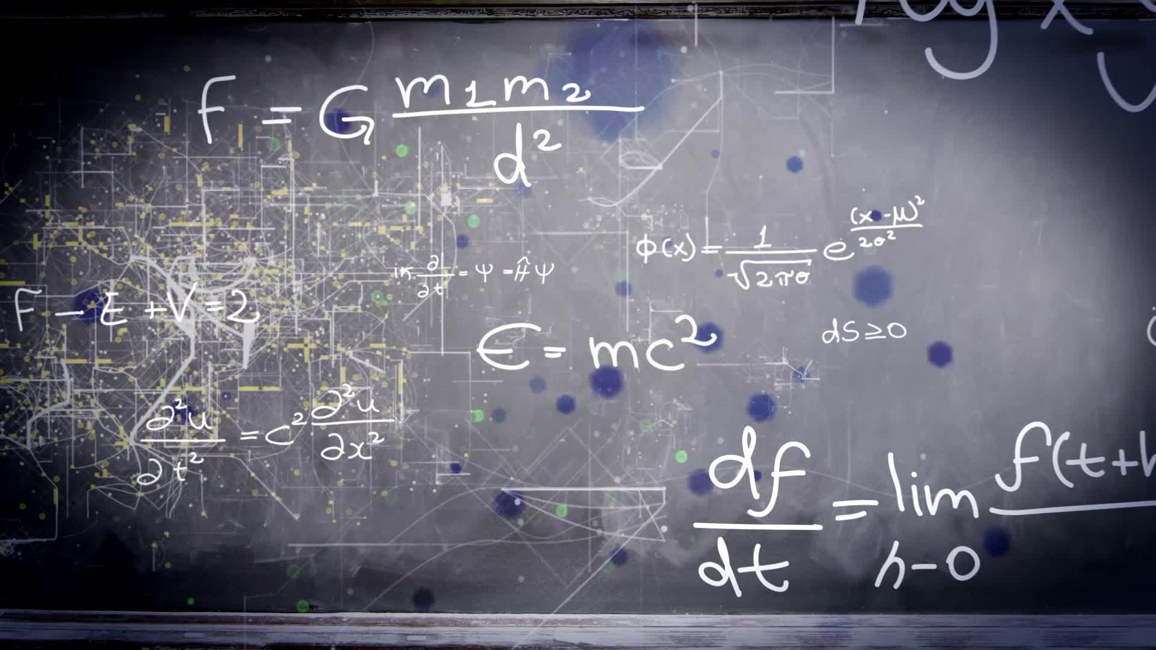
Special Relativity
Time Dilation / Length Contraction / Einsteinian Clock Synchronization

Slide 2

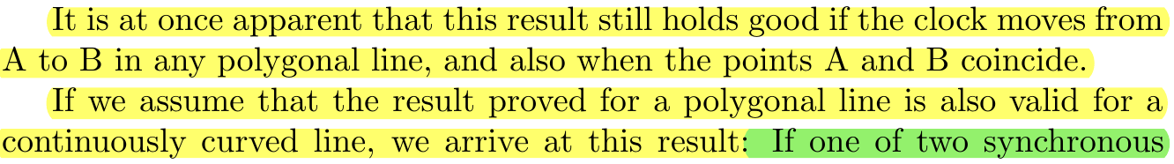
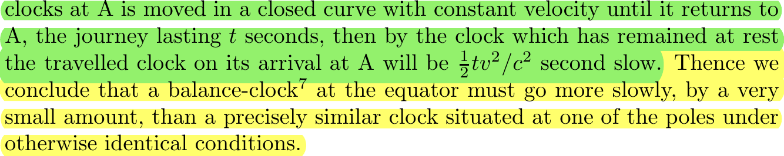

Slide 3
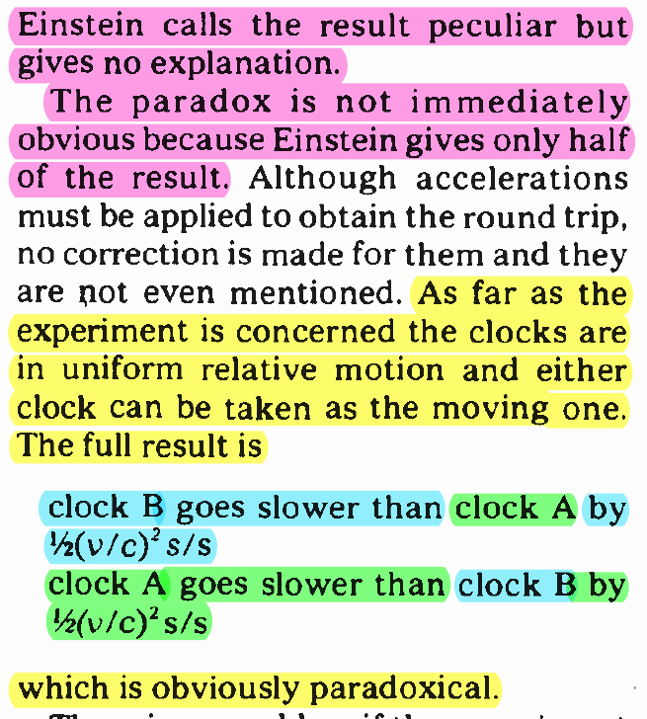

Slide 4
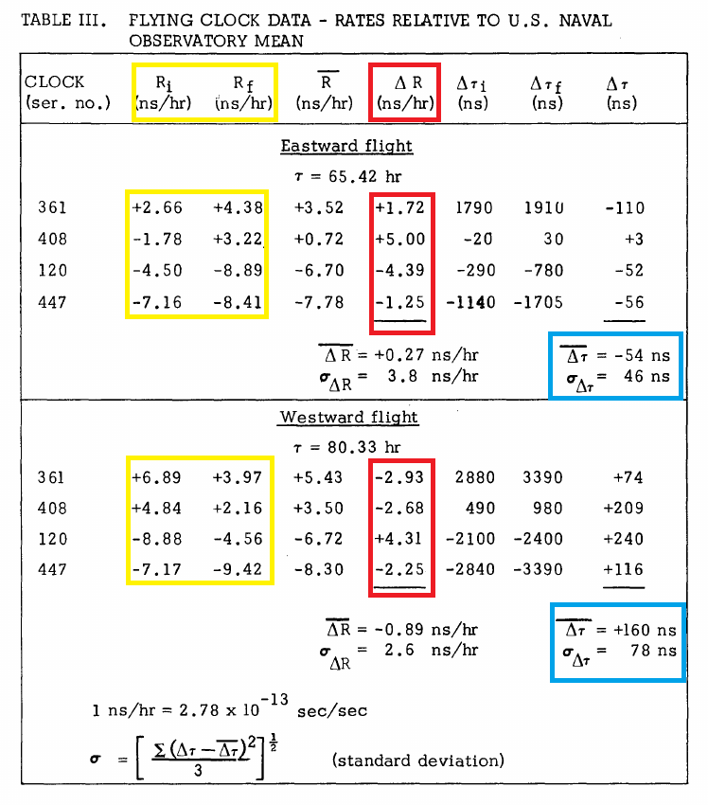
Hafele-Keating: Performance and Results of Portable Clocks in Aircraft (Original Data, 1971)
The original data from the Hafele-Keating experiment showed that three of the four clocks were unreliable and had significant variations in their drift-rates, which should have been steady in order to make accurate measurements.
Table 1 shows the drift-rates of the clocks before and after the eastward and westward tests: before and after, difference, mean.
The conclusion from the data is that the huge swings in drift rates made the results of the experiment unreliable and inconclusive. The accuracy of the clocks would have to be better by two orders of magnitude in order to reach a meaningful conclusion on the test.
Take note of the mean values, as we’ll be comparing the original recorded results before and after the “post-analysis and consolidation” was conducted which brings the results more in line with relativity theory’s predictions.
Notes:
The drift-rate is the natural rate in which the clocks should drift out of sync irrespective of motion or altitude.

Slide 5
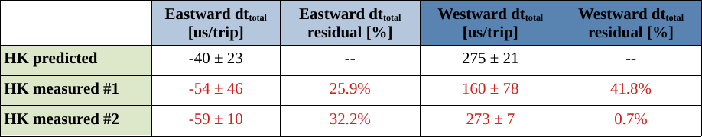
Hafele-Keating: Published Data in Science After Post-Analysis and Consolidation (1972)
Original data and the data after a post-analysis and consolidation was done.
Relativity wins again.
Notes:
It should be further noted that they declined to do a North-South circumnavigation because they said the Earth’s magnetic field is too strong and would impact the results (EM retardation). Or because N-S circumnavigation is impossible.
It is claimed that the clocks were TRIPLE shielded to cancel out (or minimize) any EM retardation for E-W / W-E.
Wouldn’t you want that data anyways just to get more accurate readings of how EM retardation would affect the readings?

Slide 6
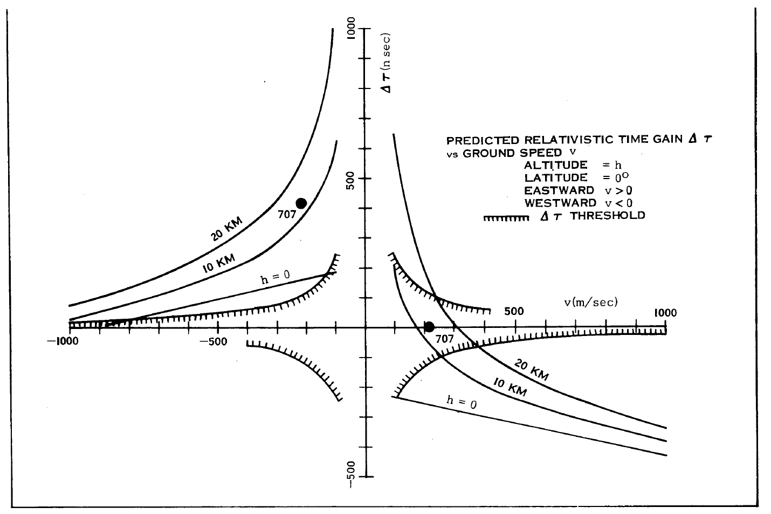

Slide 7
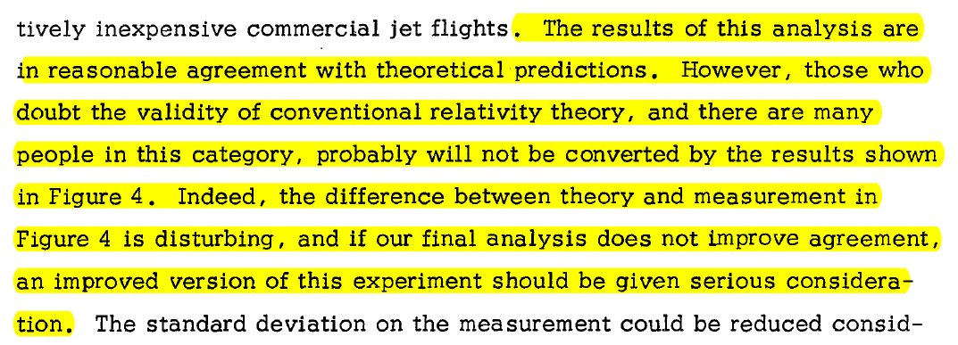

Slide 8
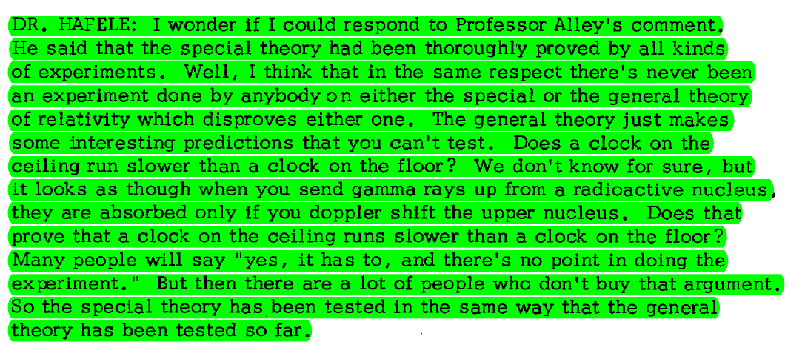

Slide 9
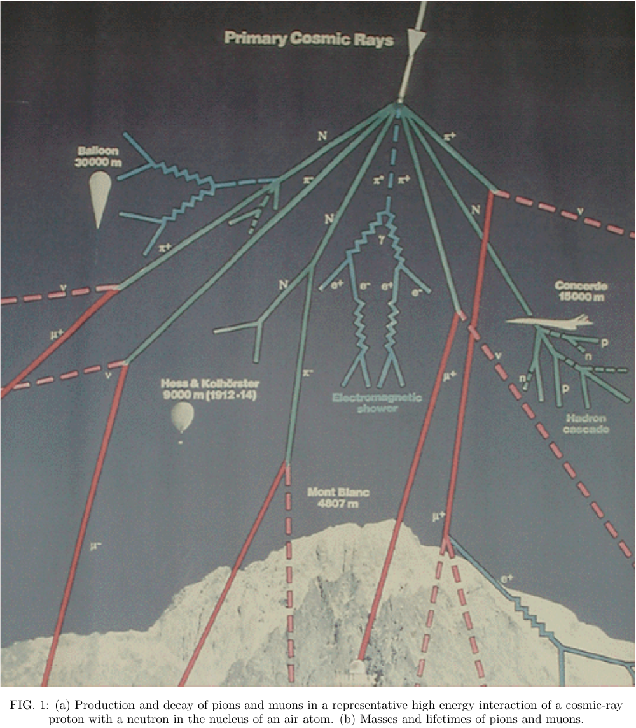

Slide 10
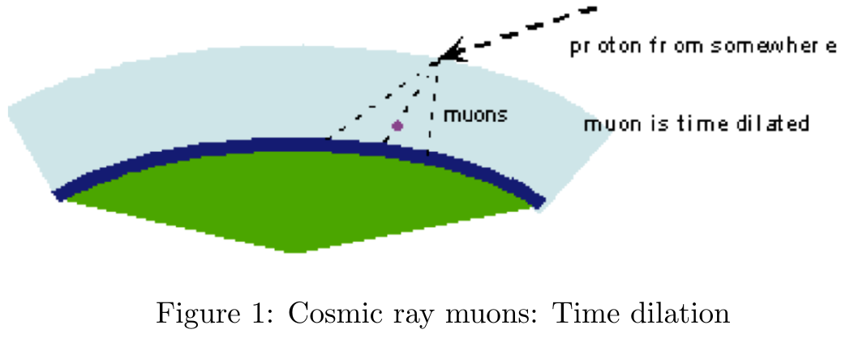

Slide 11
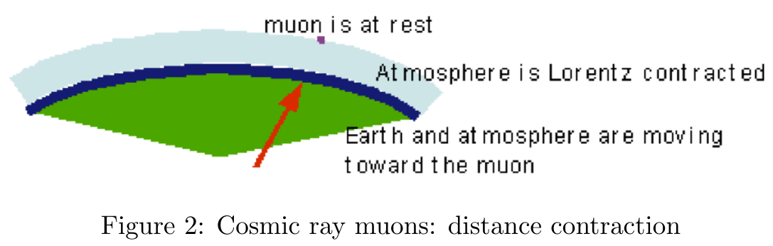

Slide 12
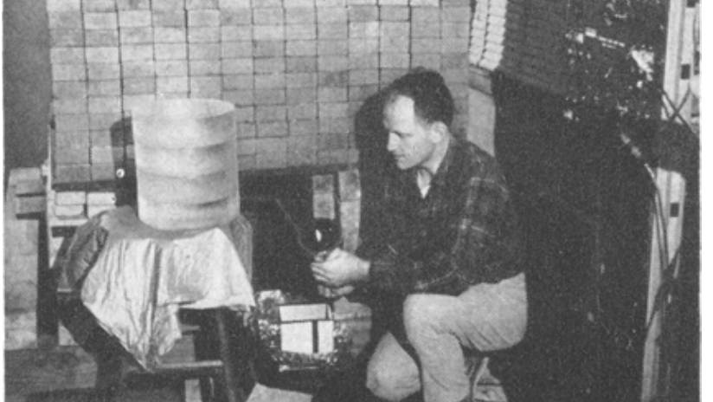
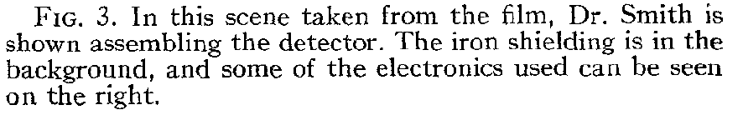

Slide 13
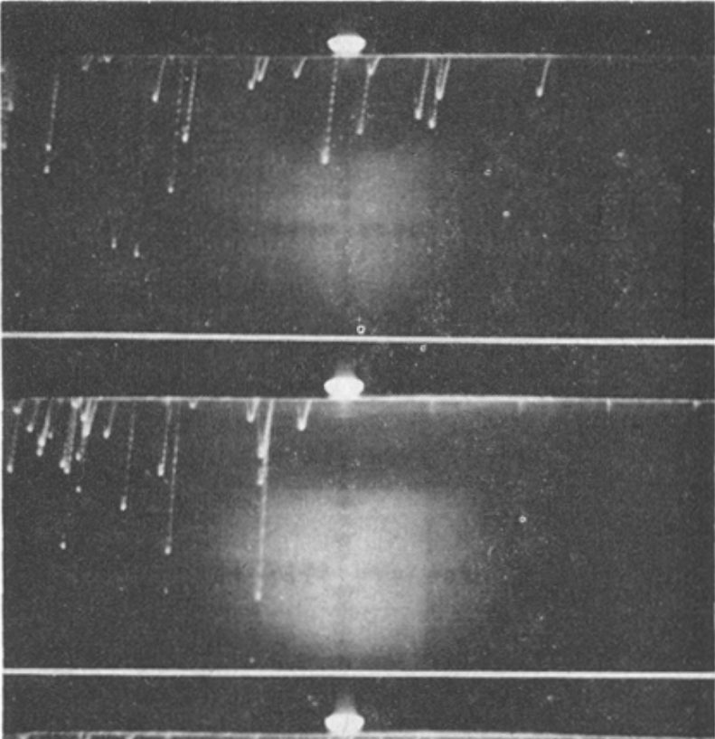

Slide 14
