Slide 1
GPS Technology and Relativity
By Space Audits

Slide 2
GPS is a TIME interval & range measurement
The first part of this presentation is to break down atomic clock synchronization.
Precise synchronization of time is what enables GPS to be so accurate
How does GPS keep time?

Slide 3
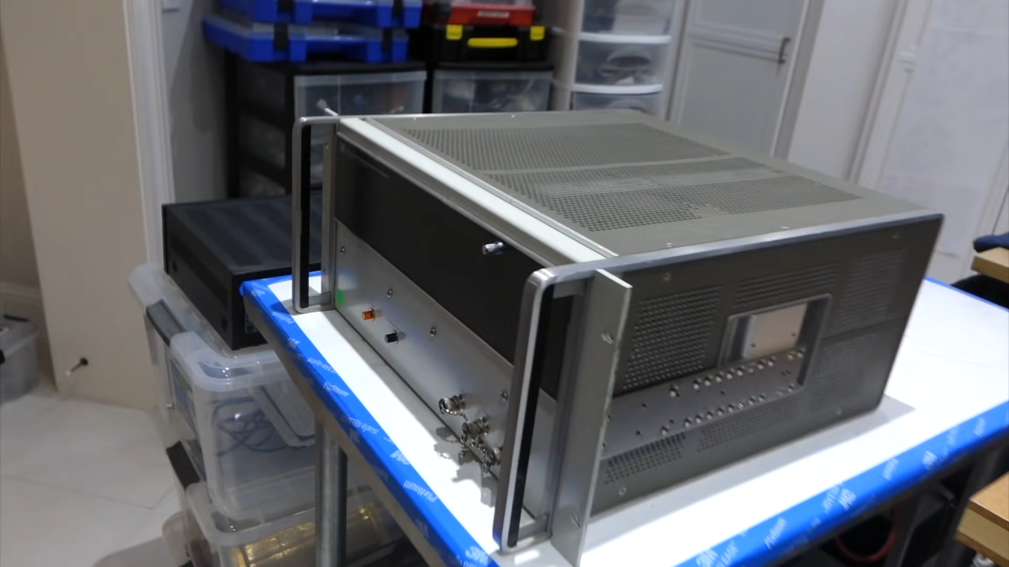
https://www.youtube.com/watch?v=eOti3kKWX-c

Slide 4
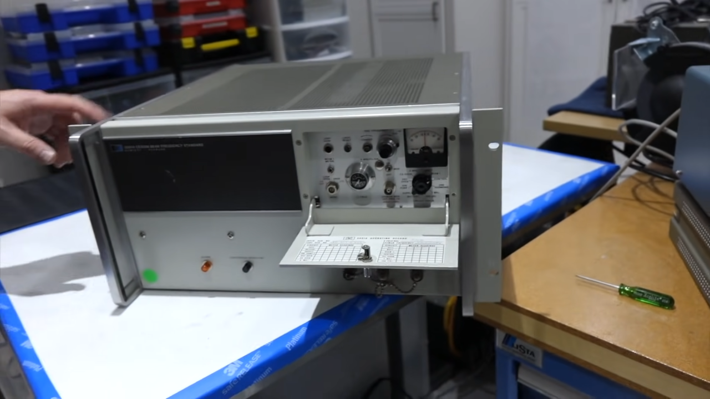
https://www.youtube.com/watch?v=eOti3kKWX-c

Slide 5

https://www.youtube.com/watch?v=eOti3kKWX-c

Slide 6
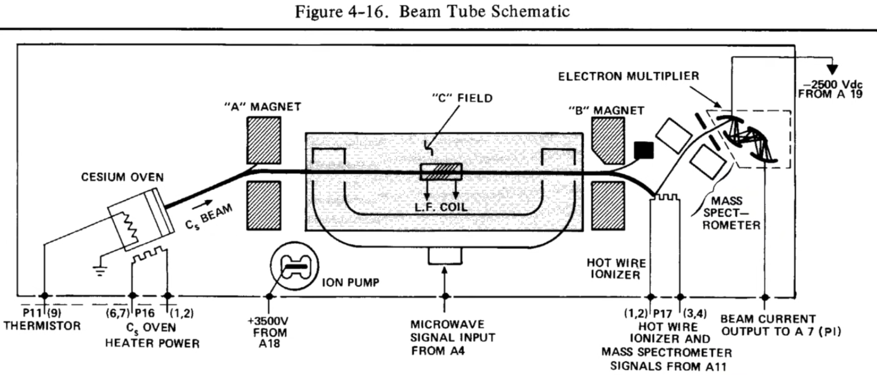
How an atomic clock works
https://www.youtube.com/watch?v=eOti3kKWX-c
Notes:
Cesium – low melting point – 1 [Atomic Model] Valence electron in the outer shell of Cesium [ periodic table: https://i.imgur.com/XI08VnQ.png ] | [ atomic model shell: https://i.imgur.com/FmmT7Lj.png ]
Vaporized Cesium collimated into a coherent beam that gets directed into a radio wave cavity using magnetic field (A). Once inside the cavity, radio waves are calibrated against the resonate frequency of the Cesium vapor (~9.192 GHz) [9.1 billion osc/s]. Exiting the rado wave cavity, only radio waves & Cesium vapor matching the 9.192 GHz are directed via magnetic field (B) to an ionizer. Ionization the Cesium vapor with radio waves at the same frequency creates an electric signal that's proportional to the osc. rate of 9.192 GHz which is measured the "electron multiplier" Once the osc./rates match, a feedback loop is created for stabilization of the radio wave frequency. The clock is now capable of keeping time down to 1/9,192,631,770th of second

Slide 7
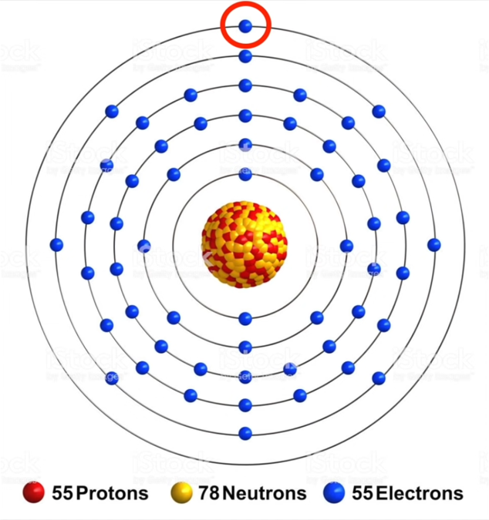

Slide 8
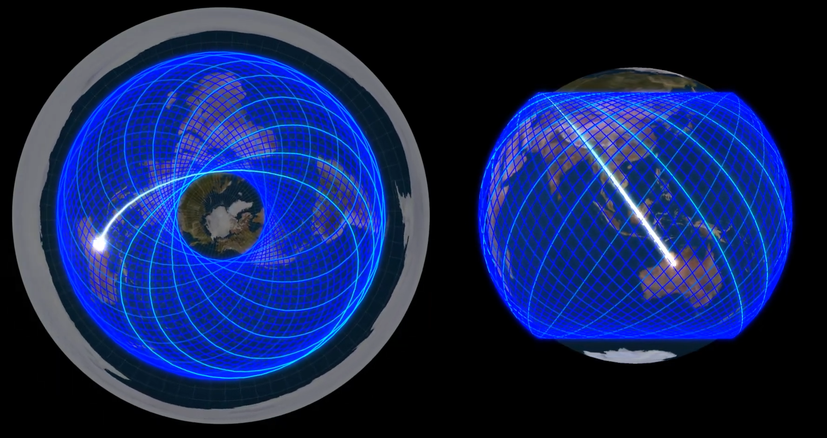
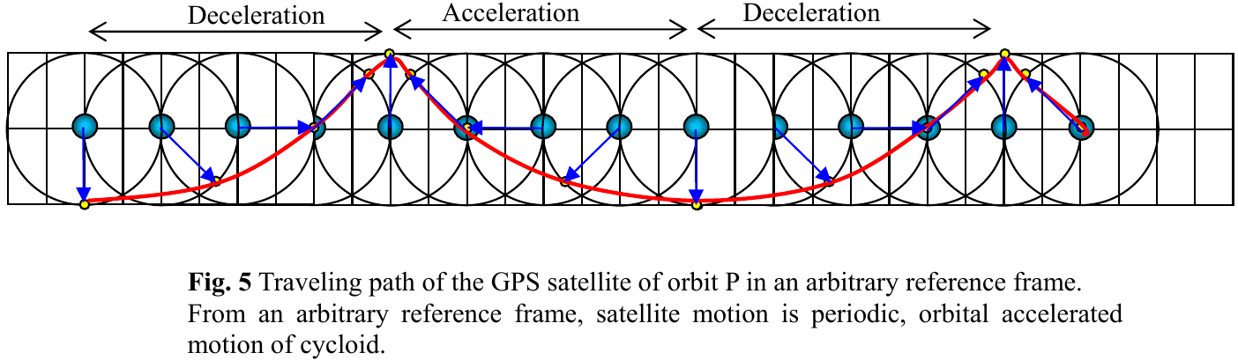
Notes:
Sato, M. (2005). "Interpretation of Special Relativity as Applied to Earth-Centered Locally Inertial Coordinate Systems in Global Positioning System Satellite experiments." arXiv preprint physics/0502007.
If all reference frames were truly valid and additional velocity vectors existed, they would have to be accounted for.
In the way the “universal reference frame” would see it. The clock synchronization and variance caused by the additional velocity vectors would be manifest in our frame, regardless of how the orbit appears to us (elliptical or cycloidal)
The fact that the clocks are synced to the ECI time and show no variance due to the additional velocity vectors
The logical conclusion is the additional vectors do not exist.
“We cannot detect any annual deviations dependent on the velocity of the earth.” pg. 7
If the orbital paths are ellipsis, we’re stationary because that’s how all our clocks are sync’d.
Orbital differences picture
Ref from the solar system shows the orbital as a curve, not a line [cycloid]

Slide 9
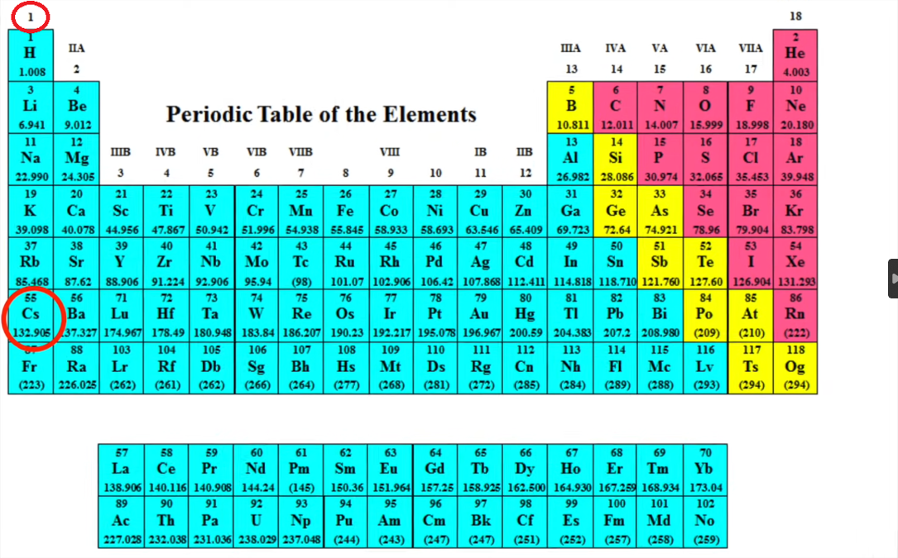
Valence electrons
Total electrons in the nucleus

Slide 10
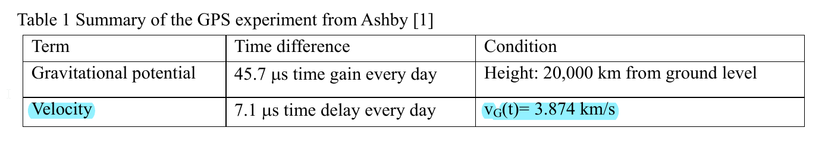
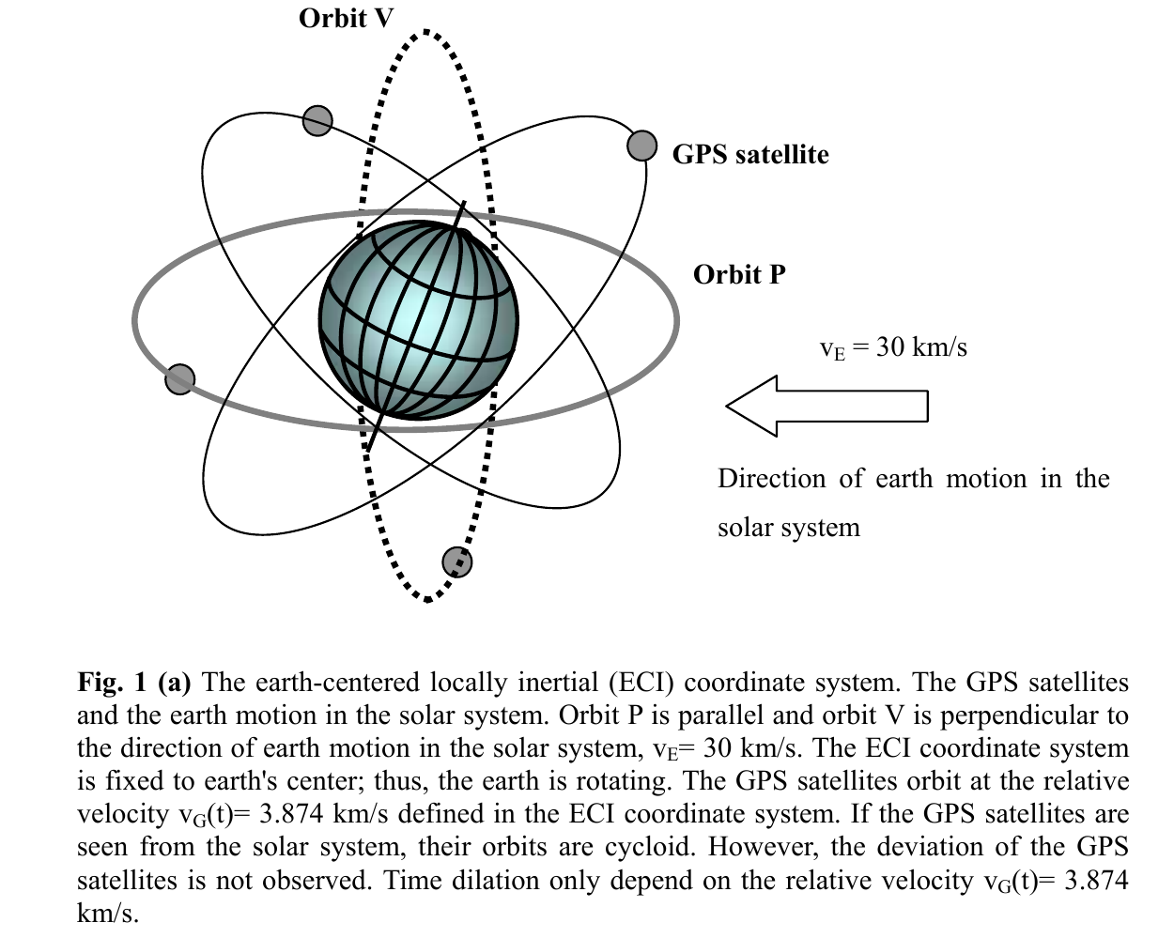
Notes:
Sato, M. (2005). "Interpretation of Special Relativity as Applied to Earth-Centered Locally Inertial Coordinate Systems in Global Positioning System Satellite experiments." arXiv preprint physics/0502007.

Slide 11
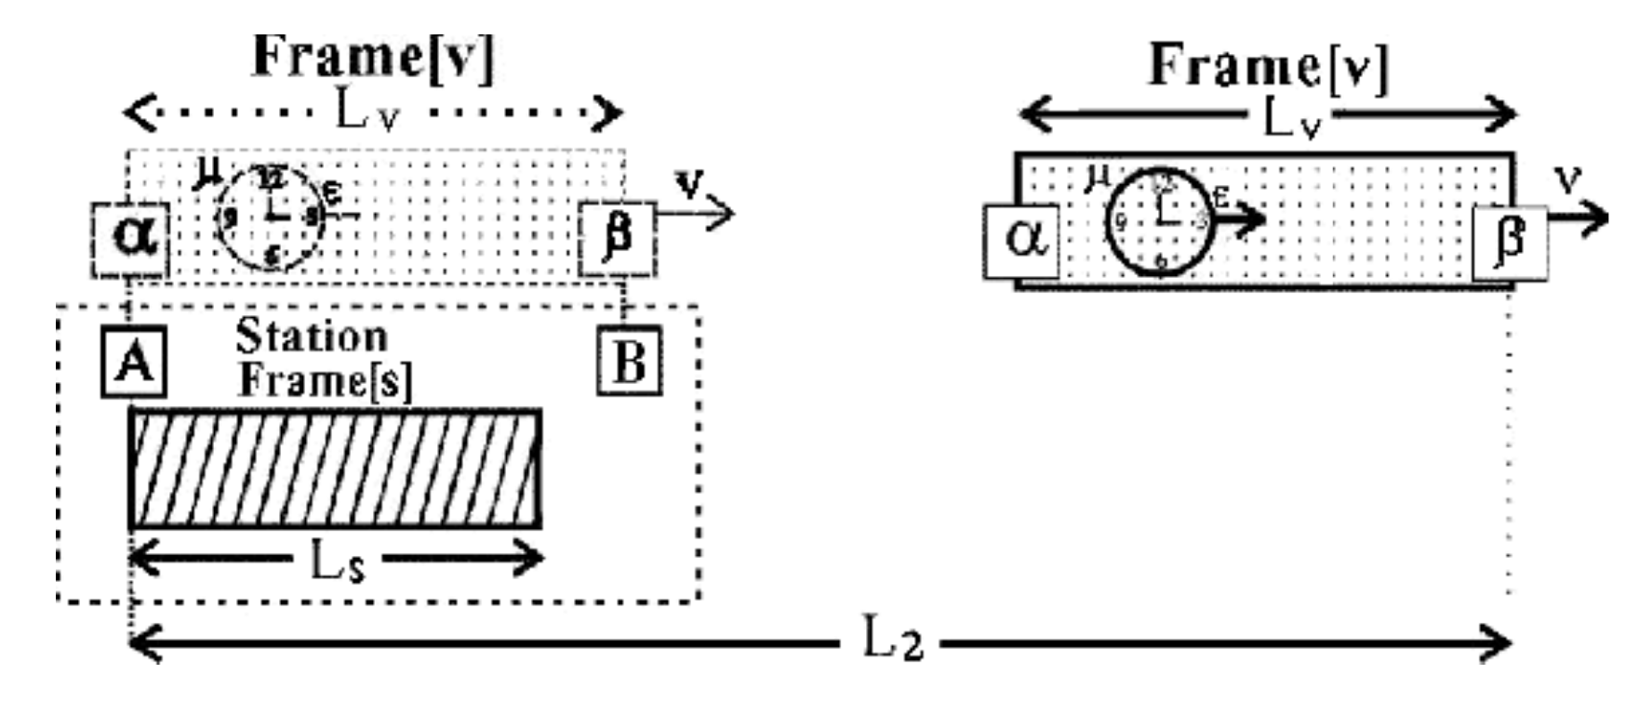
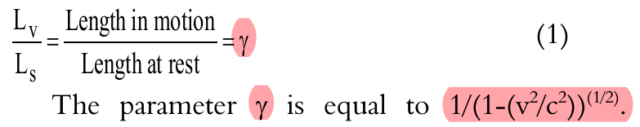
Einsteinian Clock Synchronization
Assume that the speed of light (c) is constant for both two-way and one-way trips.
When the moving clock α intersects with the stationary clock A, a signal is sent to β encoding α's start time.
Moving clock β receives the signal and applies a half-time (1/2) correction to account for the travel time of the light signal.
The moving clock b and stationary clock B then synchronize their times with A and a using this corrected signal.
Any time difference between the moving clocks α and β is adjusted to match the stationary clock A and moving clock α.
1
5
2
4
3
Notes:
In theory, once this 5-step process is complete, the clocks should be in synch perpetuity since c is known and constant.
Assuming the relative velocity between the stationary clock and moving clock remains constant.

Slide 12
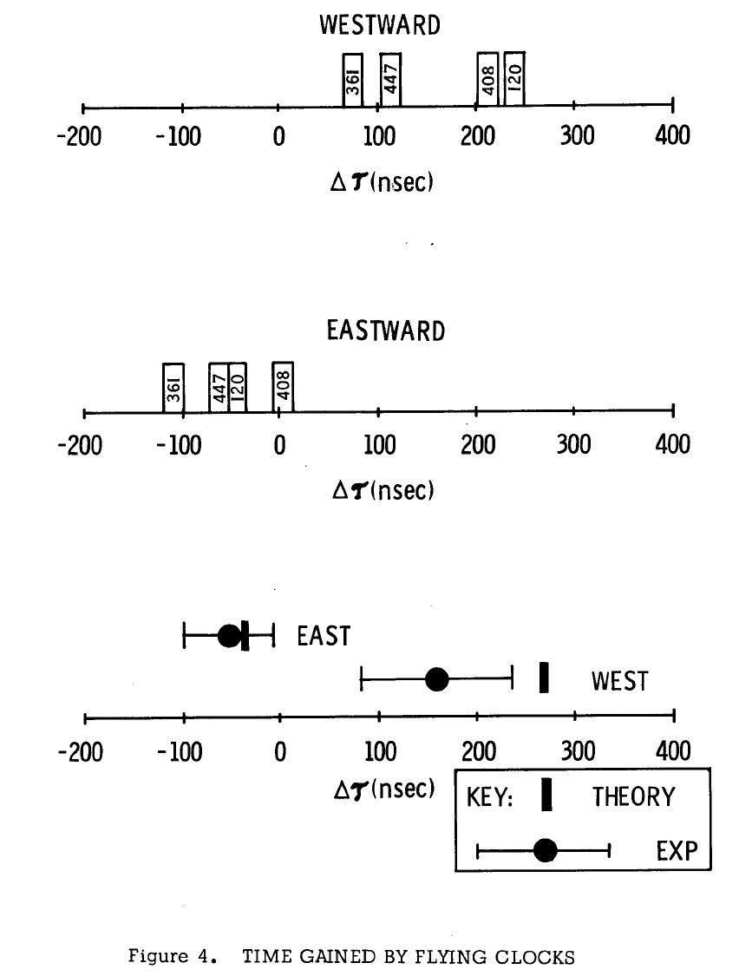
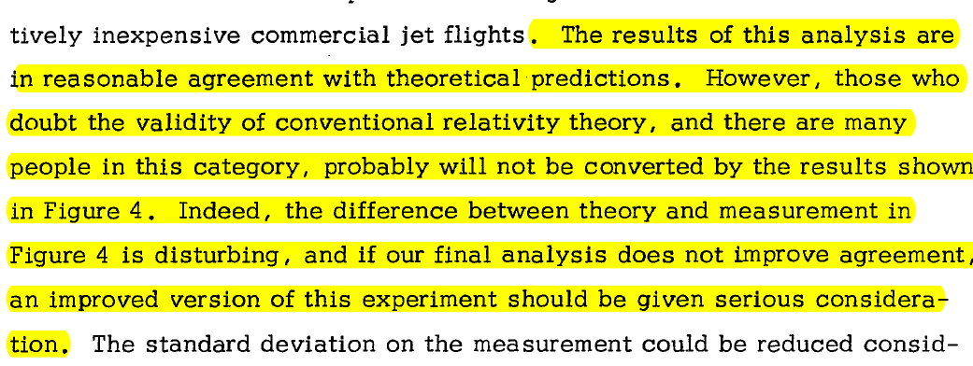
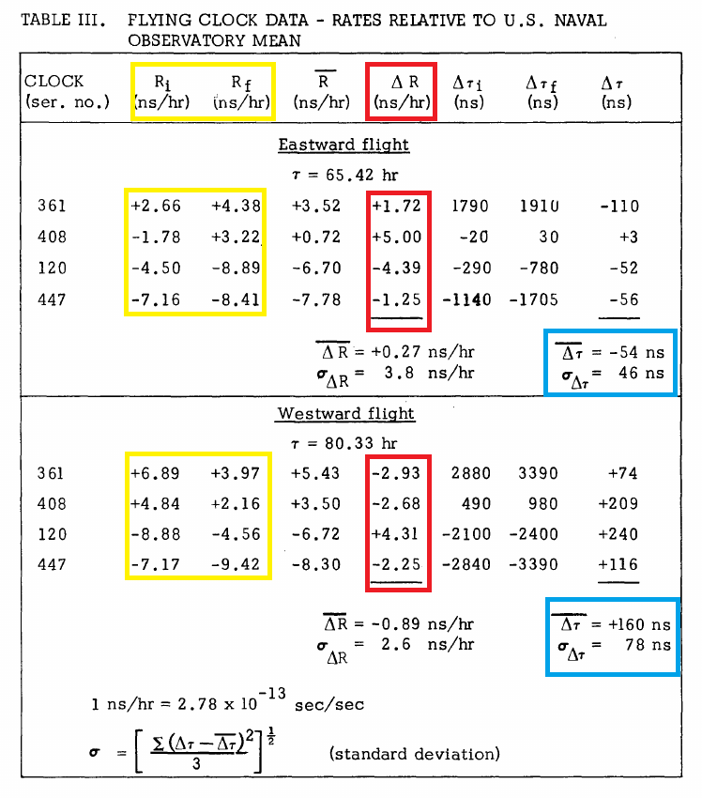
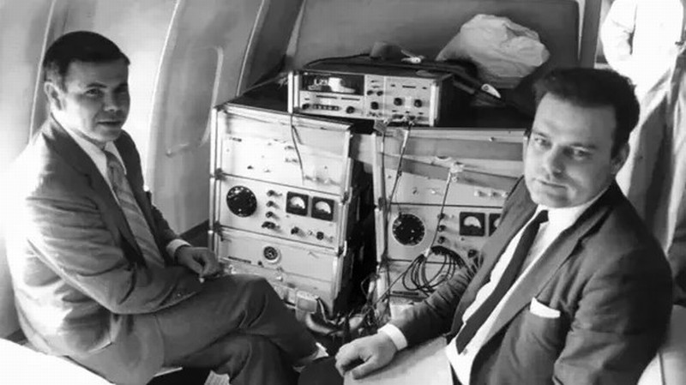
Hafele-KeatinG

Slide 13
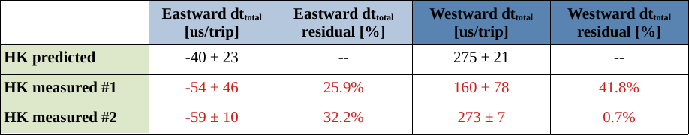
HK: Post Analysis & Mathematical consolidation
Notes:
Question: HK worked then, right? Atomic clocks are synchronized in accordance with Einstein?

Slide 14
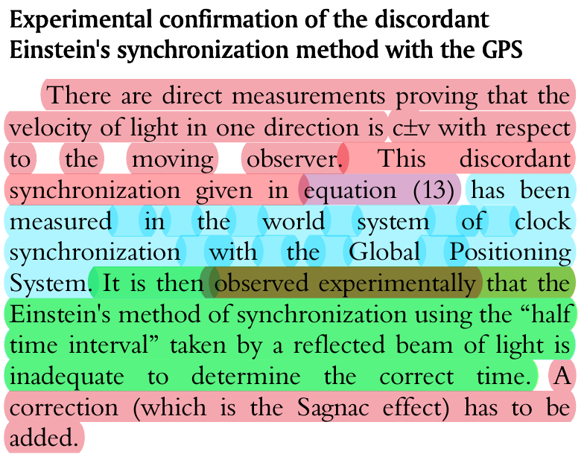
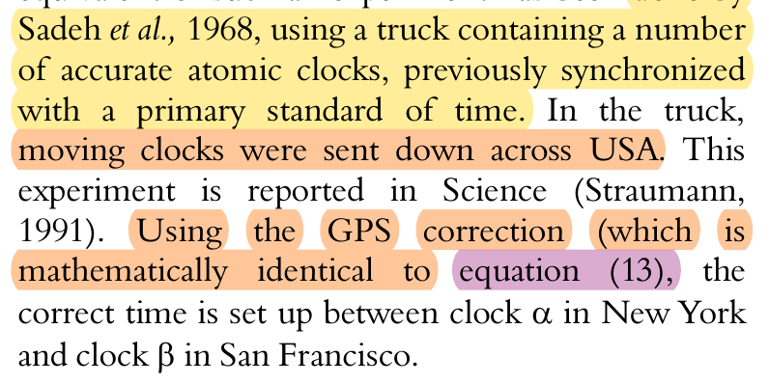
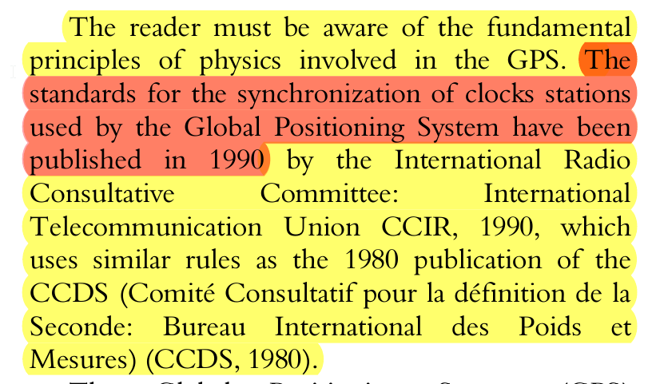
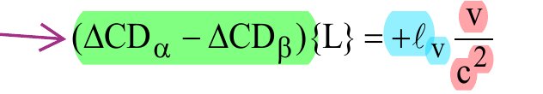

Sagnac Corrections
Notes:
L = physical distance between clocks a and b [a and b can be satellites and ground stations]
l_v = Earth rotation relative to center of the ECI – didn’t work – required an extra term [Ether Wind relative to the latitude]
2v/c^2= velocity as a fraction of the SoL of satellite WRT relative earth rotation [Ether Wind] Relative velocity of the craft RWT Ether wind relative to the latitude
Velocity correction experimentally substantiated in Sadeh et al. (68). c = c +- v confirmed

Slide 15
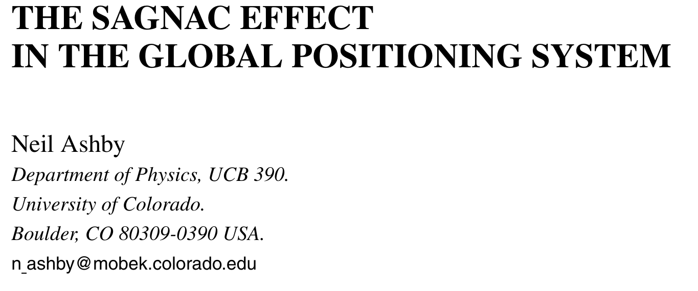
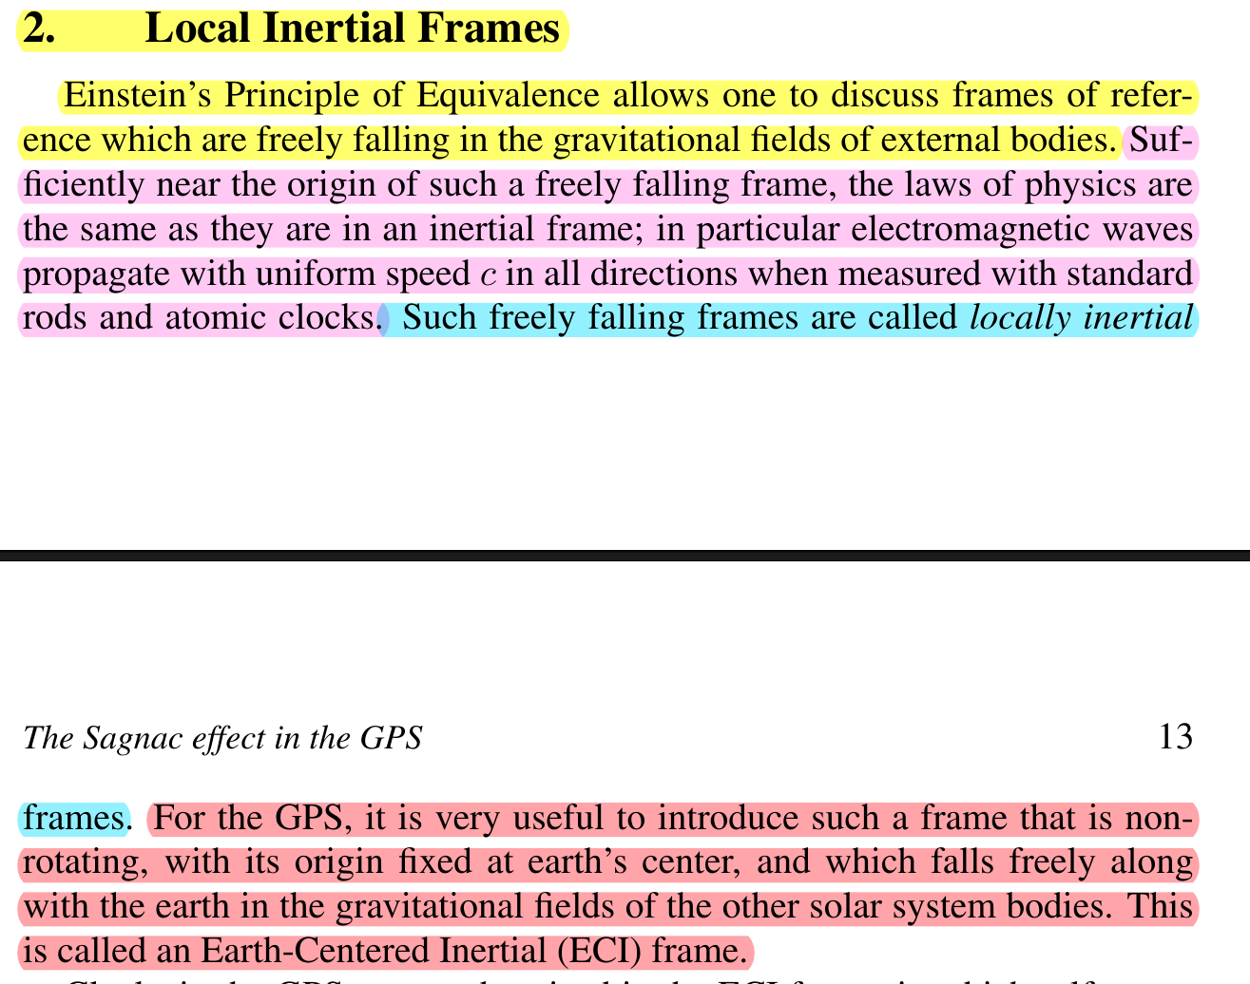
Notes:
If the Sagnac effect is accounted for in a free-falling satellite, then, Earth’s orbit, free fall or otherwise should be detectable by interferometry [linear or circular]
Definition of an inertial frame and what it’s relative to, and how to define the orbit of a satellite

Slide 16
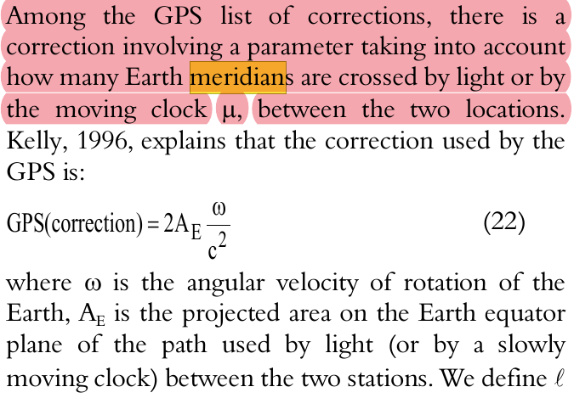
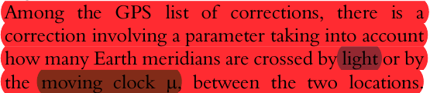
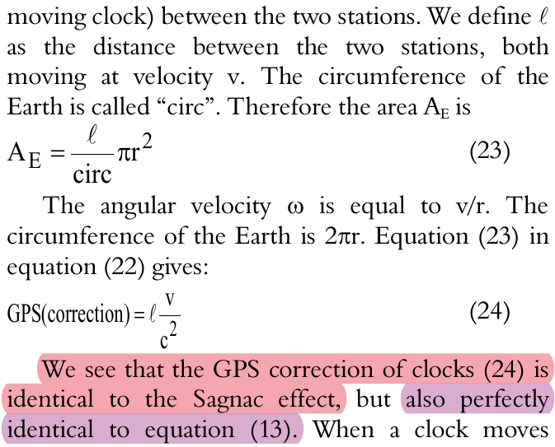
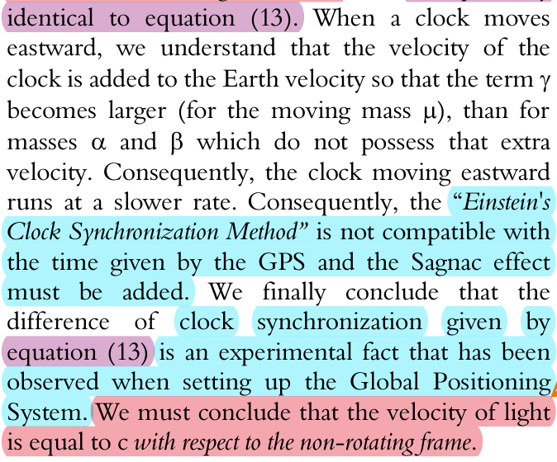
Meridian Corrections
Meridian corrections are coordinate system corrections applied to the travel time of the SoL.
Using scale invariance, the measurements taken by GPS will always output distances and relative locations to match the globular coordinate system.
Marmet, P. (2000). "The GPS and the Constant Velocity of Light." Acta Scientiarum.
Notes:
Meridian corrections are coordinate system corrections to the travel time of the SoL. This ensures any measurement taken by GPS will always reduce back to globular coordinates.
Ether wind correction relative to the latitude [synch to sidereal time] + velocity of transport craft

Slide 17
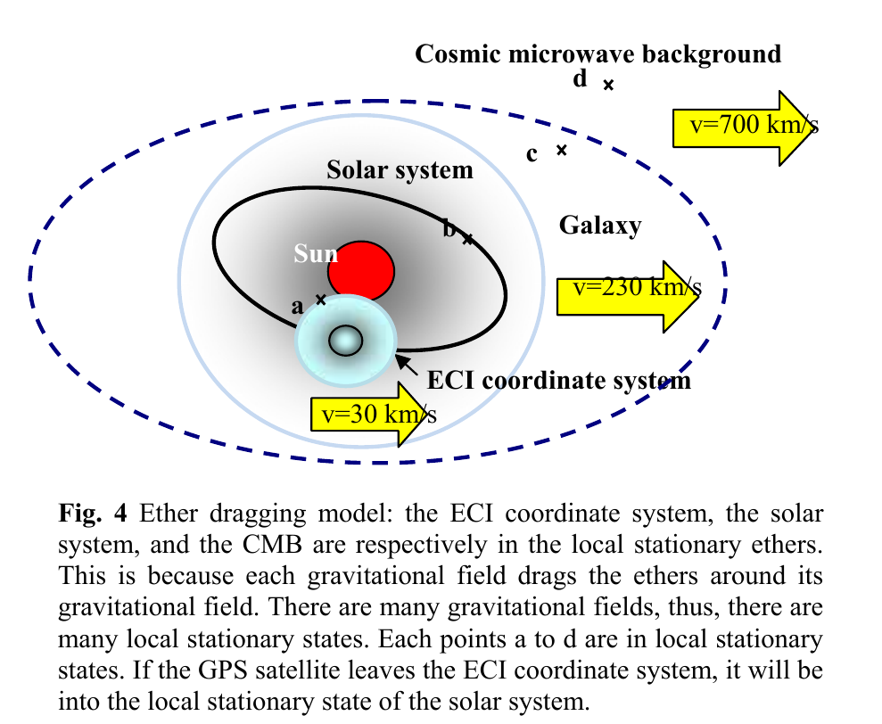
Corrections they don’t make
Notes:
All clocks sync to ECI, no additional velocity corrections

Slide 18
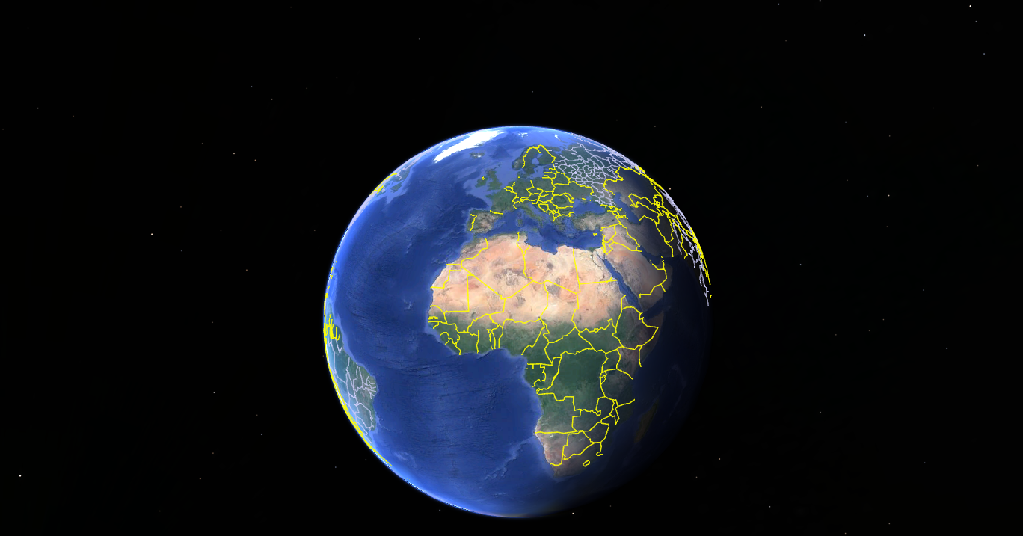
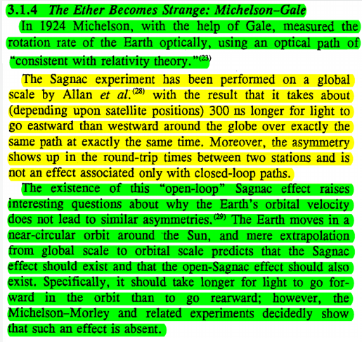
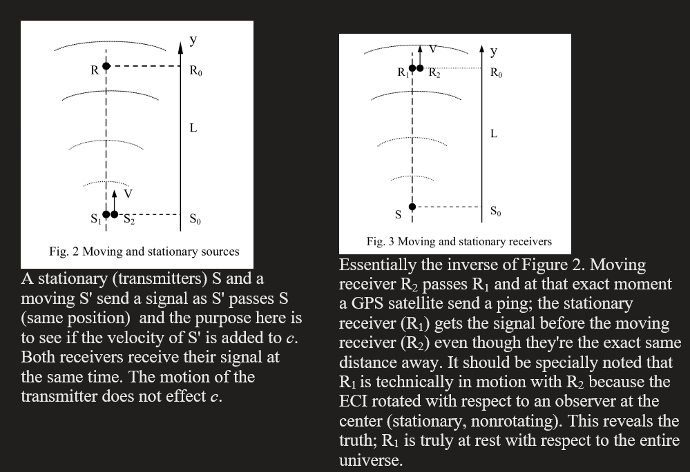
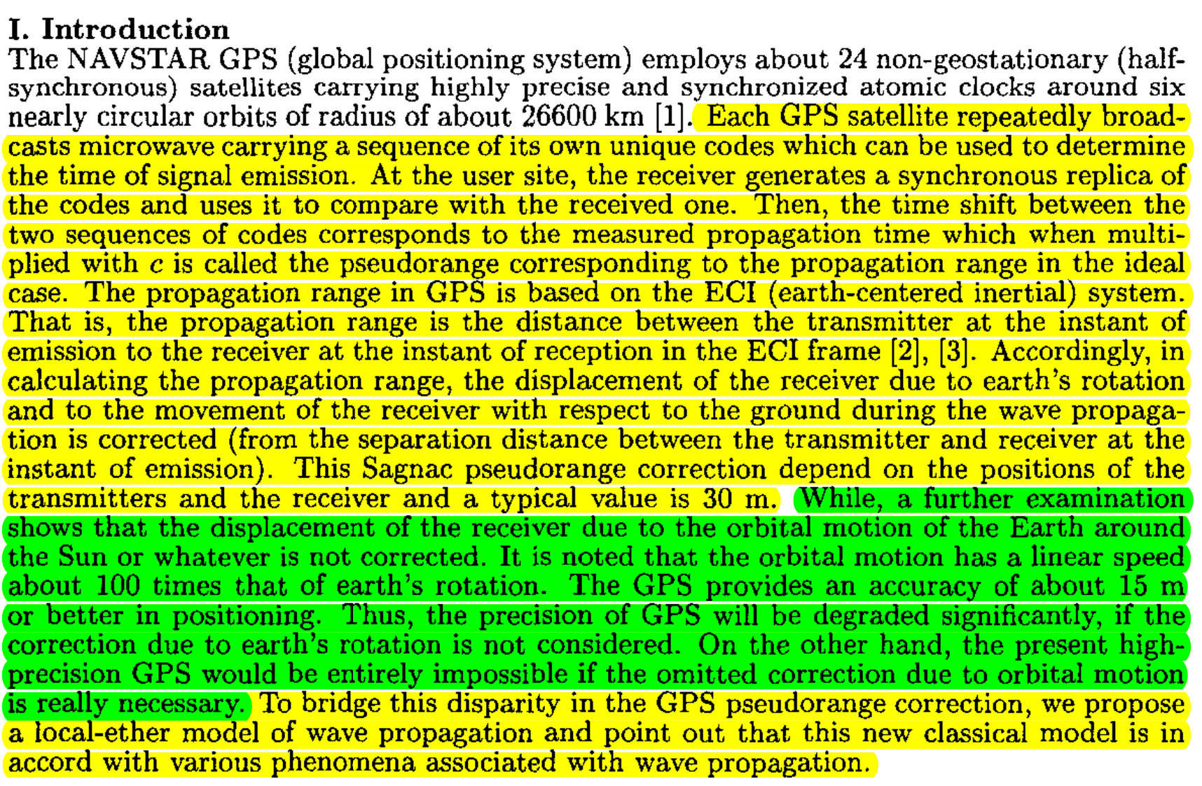
Earth’s Nonexistent orbital velocity
Earth’s assumed, never measured or accounted for orbital velocity: ~30km/s
GPS specifically doesn’t account for the presupposed orbital velocity of the earth around the sun. the orbital motion is a linear speed 100 times that of earth’s rotation and would have to be accounted for in addition to earth’s daily rotation.
The Sagnac effect is revealed in the gps’ range measurement equation as an effect of an ether wind with respect to a stationary, non-rotating earth.
Daily Rotation:
Angular velocity: 15°/h.
Translation speed: 1000,mp/h at the equator. Varies with latitude.
1. Howard C. Hayden, Special Relativity: Problems and Alternatives, Physics Essays, Vol. 8, 3, 1995
2. Ching-Chaun Su, A Local-Ether Model of Wave Propagation Complying with the Sagnac Correction in the Global Positioning System, Antennas and Propagation Society International Symposium, 2000
3.Fig 2. and Fig. 3 (respectively), Ruyong Wang, Re-examine the Two Principles of Special Relativity and the Sagnac Effect Using GPS’ Range Measurement Equation, Pg. 3-4, 2000
4. Stephan Gift, Faster West than East: The GPS Invalidates Special Relativity, Proceedings of the NPA, 2013
Notes:
1. Howard C. Hayden, Special Relativity: Problems and Alternatives, Physics Essays, Vol. 8, 3, 1995
2. Ching-Chaun Su, A Local-Ether Model of Wave Propagation Complying with the Sagnac Correction in the Global Positioning System, Antennas and Propagation Society International Symposium, 2000
3.Fig 3 and Fig 3.Ruyong Wang, Re-examine the Two Principles of Special Relativity and the Sagnac Effect Using GPS’ Range Measurement Equation, Pg. 3-4, 2000

Slide 19
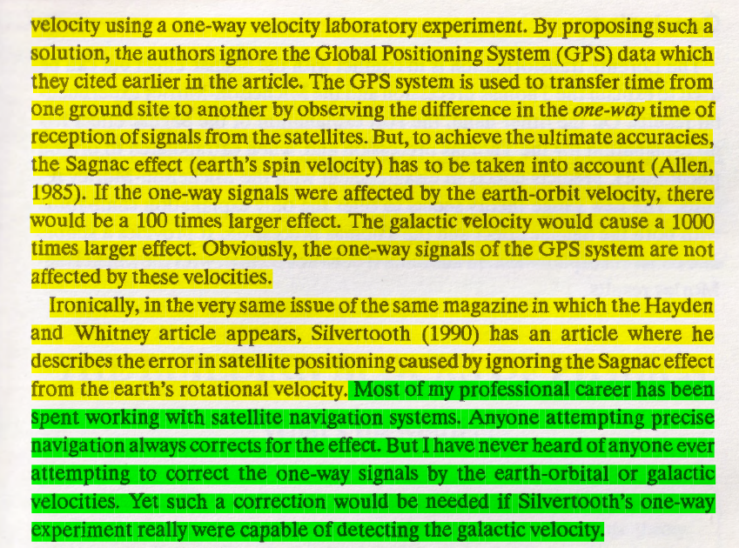
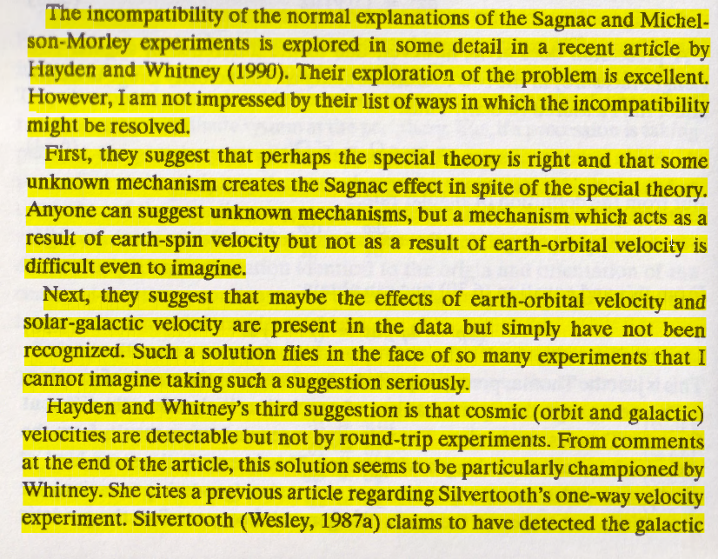
Ron Hatch: Escape From Einstein

Slide 20
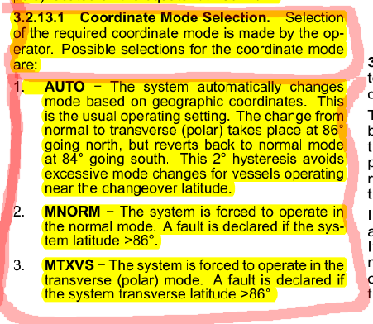
Notes:
INS
RLG Polar coordinate switch @ 85 N lat.
Atomic Meridian sync

Slide 21
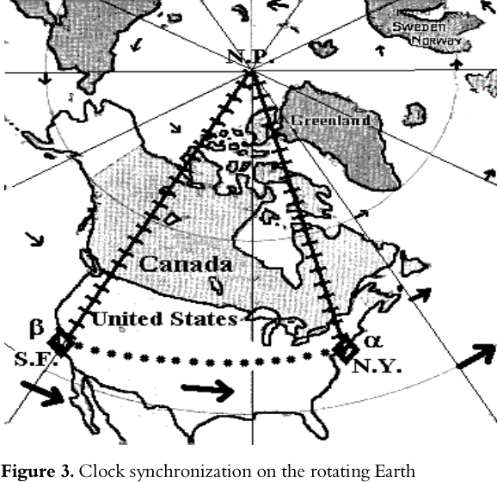
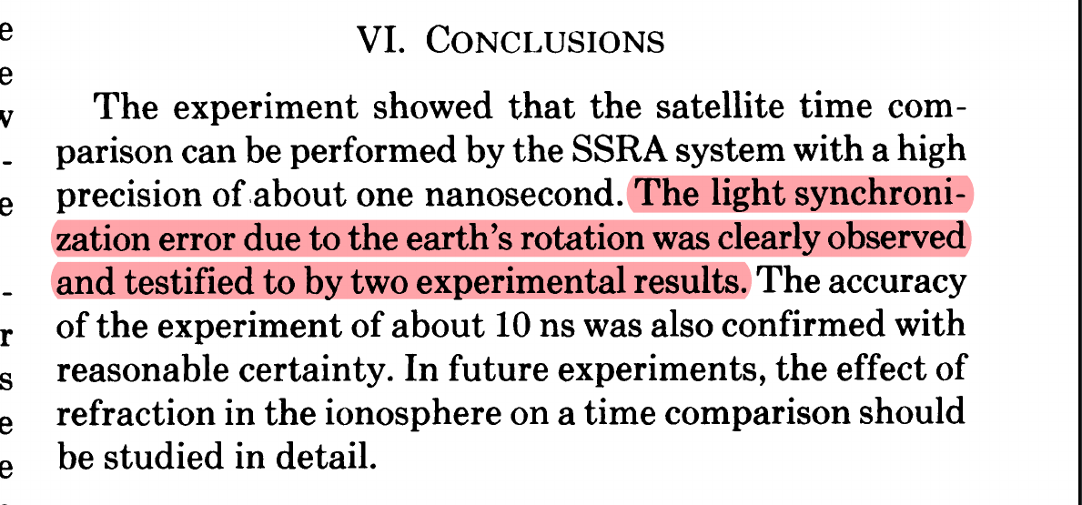
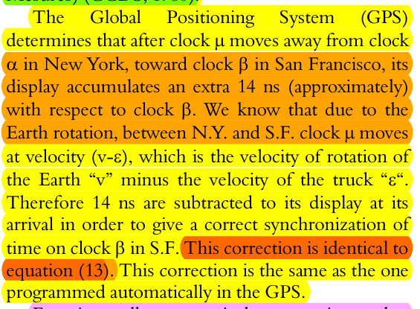
MAP SLIDE
Marmet, P. (2000). "The GPS and the Constant Velocity of Light." Acta Scientiarum.
Saburi, Y., et al. (1976). "High-Precision Time Comparison via Satellite and Observed Discrepancy of Synchronization." IEEE transactions on instrumentation and measurement IM-25(4): 473-477.
Notes:
Einstein clock synch doesn’t work
Relative velocity of the craft transporting the clock must be corrected for
If the satellites are synched to the ECI, then the implication is it can only be account for their absolute velocity WRT absolute space (center of the ECI)
[Saburi] Washington to Tokyo 14ns delay

Slide 22
Range Measurement Equation
Now that we know how GPS keeps time and location in reference to the ECI coordinate system, we can understand how GPS uses the induction rate of c when multiplied against time to get a distance.

Slide 23
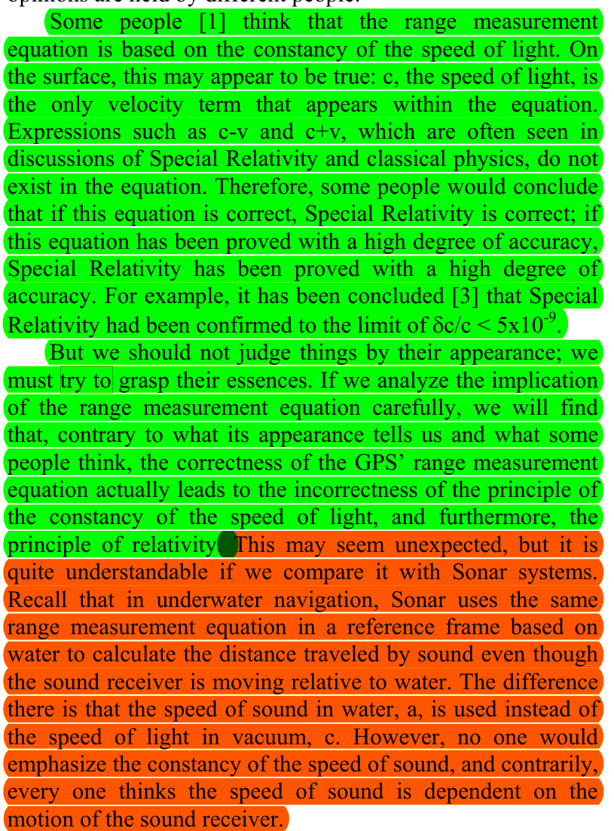

Slide 24
GPS’ Range Measurement Equation:
|r_{r}(t_{r}) - r_{s}(t_{s})| = c(t_{r} - t_{s})
This derives distance by measuring the time difference between two events (i.e., transmission time (t_{s}) and receiver time (t_{r})
GPS range equation considers the time delay between transmission and reception to determine distance, while the traditional distance equation measures the spatial separation between two points at a specific moment in time.
t_{s} = Time of transmission of the signal from source
t_{r} = Time of reception at the receiver
r_{s}(t_{s}) = ECI coordinate system position of the source at the transmission time
r_{r}(t_{r}) = ECI coordinate system position of the receiver at reception time
c = the invariant speed of light; independent of source of receiver; ~300,000 km/s
|r_{r}(t_{r}) - r_{s}(t_{s})| represents the range, which is the distance between the position of the receiver at reception time: r_{r}(t_{r}) and the position of the source (satellite) at transmission time: r_{s}(t_{s})
= c(t_{r} - t_{s}) The range is directly proportional to the time difference t_{r} - t_{s} and the speed of light, c.

Slide 25
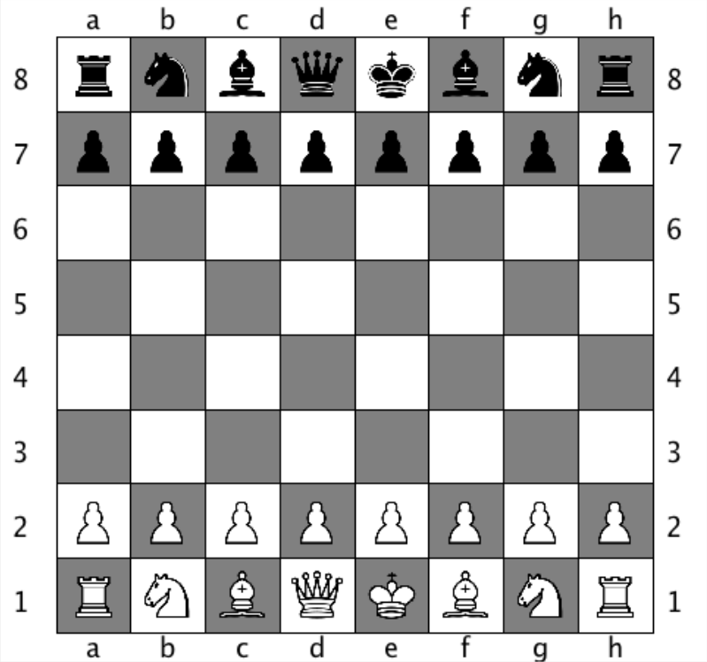
Visual difference between a time interval system and traditional distance derivation
|r_{r}(t_{r}) - r_{s}(t_{s})| = c(t_{r} - t_{s}) vs D₁ = |r_{A}(t₁) - r_{B}(t₁)|

Slide 26
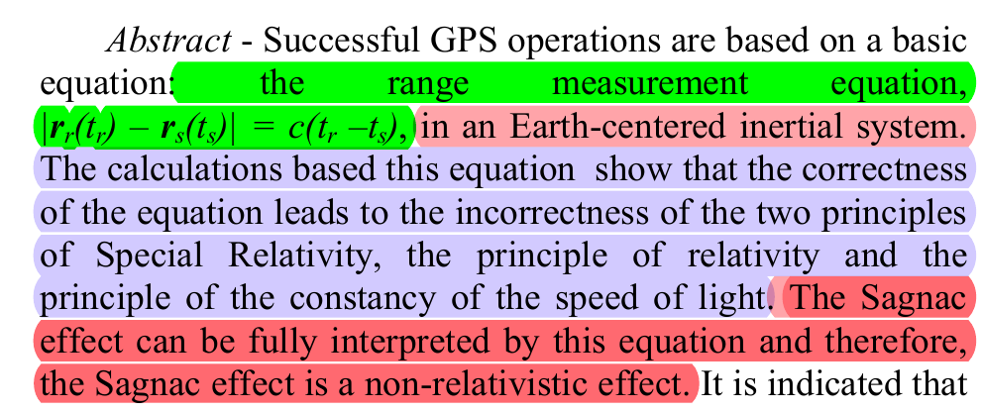

Slide 27
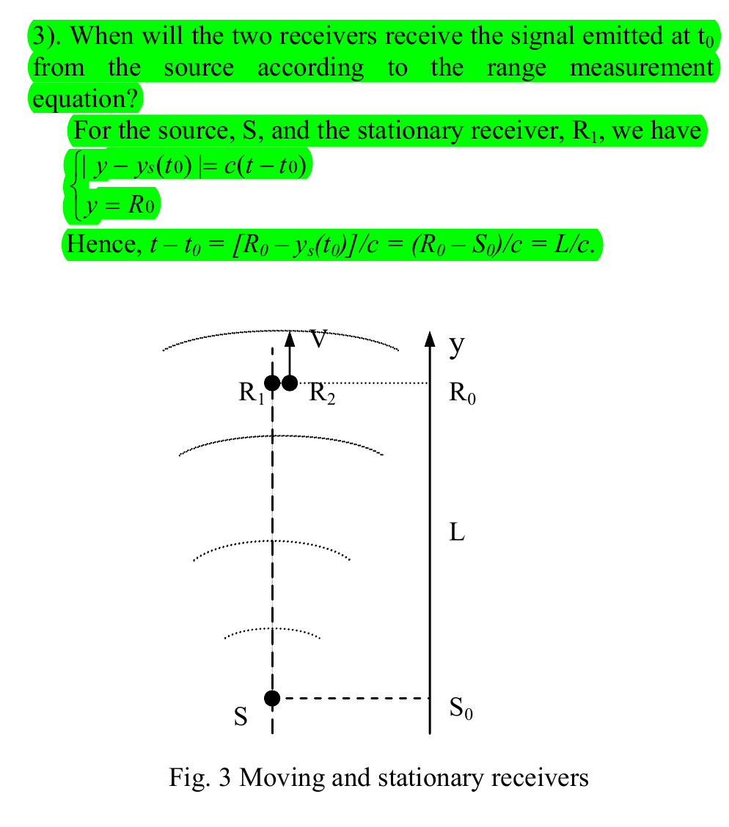
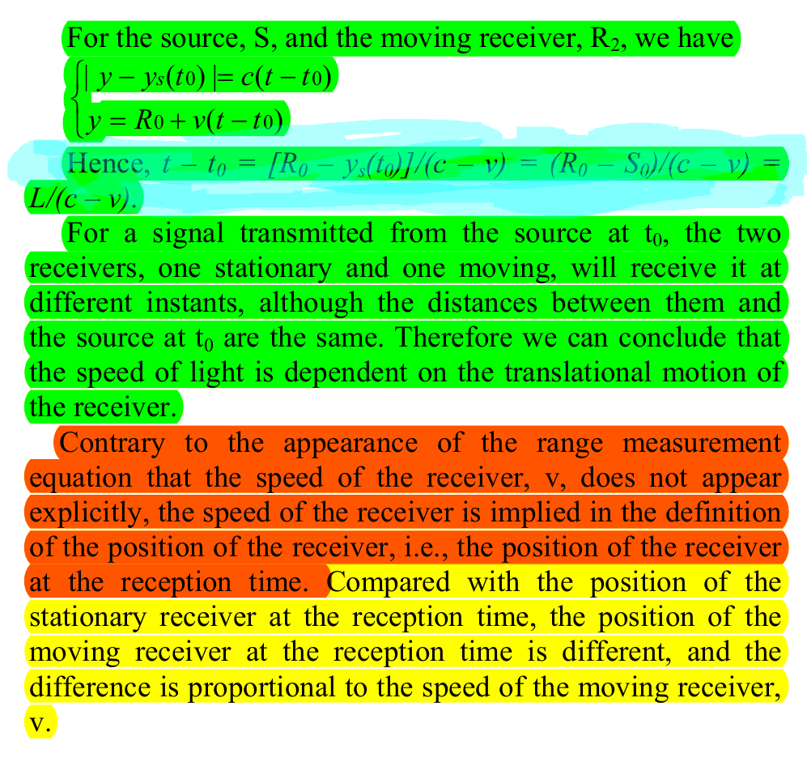

Slide 28
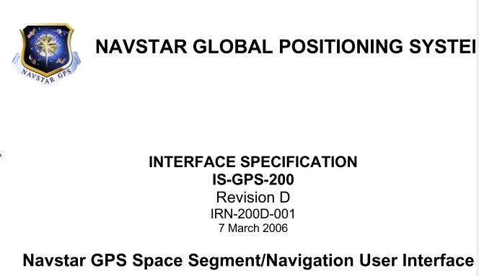
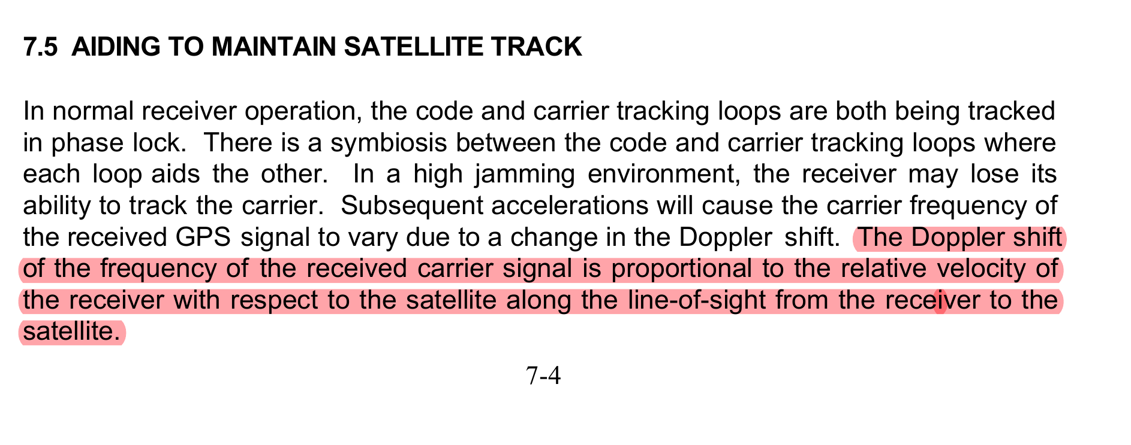
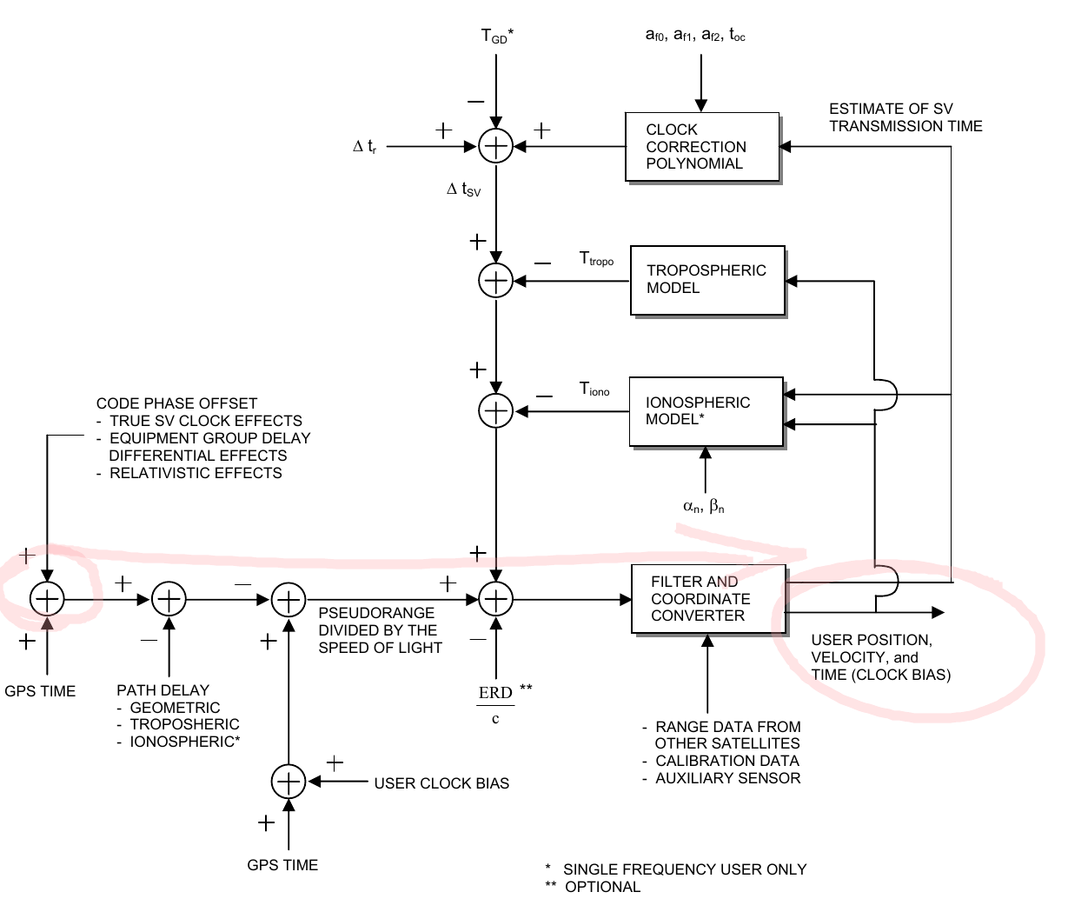
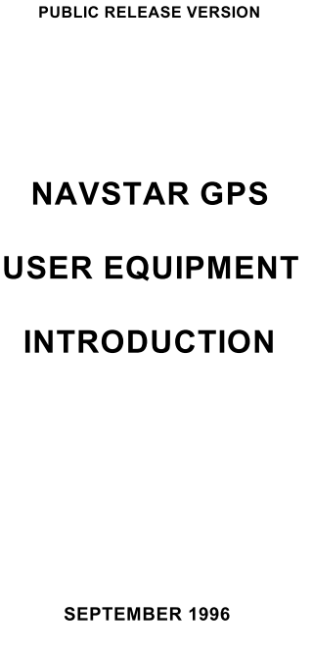
Wang is full substantiated in ICD

Slide 29
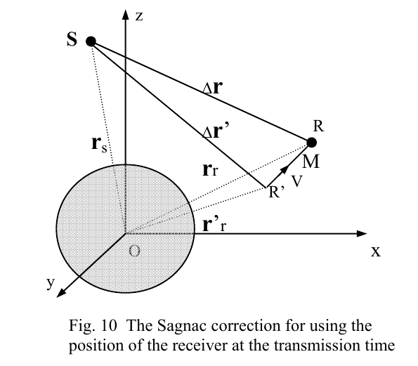
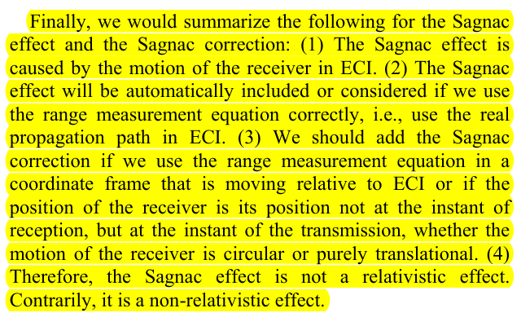
How they want you to conceptualize Satellites and GPS

Slide 30
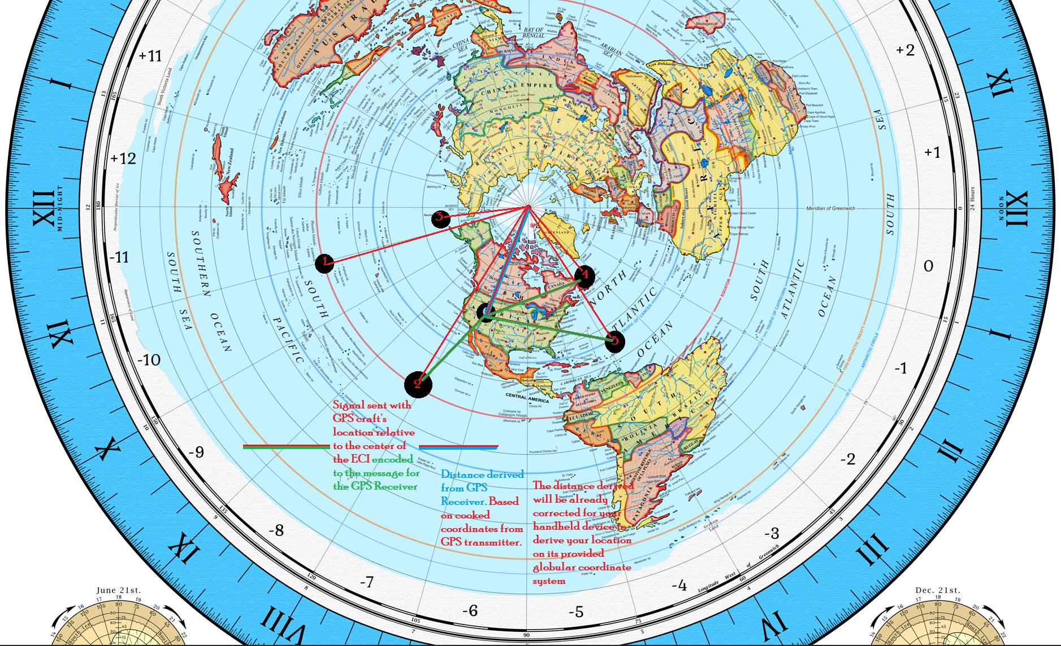
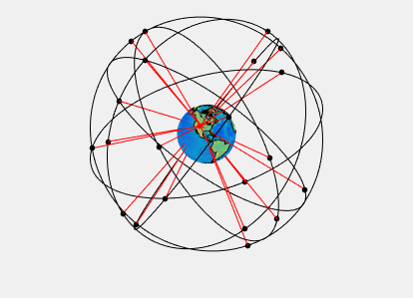
By Paulsava - Own work, CC BY-SA 4.0, https://commons.wikimedia.org/w/index.php?curid=47209685
Notes:
1-5 Satellites
6 GPS Receiver
Meridian corrections

Slide 31
Principle of Relative Simultaneity Not accounted for in GPS
The proposed constancy of the speed of light
c is a fundamental postulate of the theory of Special Relativity. As a consequence of this postulate of constancy, observers moving relative to each other will not perceive events as occurring simultaneously—a phenomenon called “relative simultaneity”. This lack of a universal timeline for events is a direct consequence of the invariance of c, which mandates that the measurement of time intervals and spatial distances will differ between observers in relative motion.

Slide 32


Notes:
The Principle of Relative Simultaneity (PRS)
An emergent property of the constancy of c is that there’s no cohesive chain of events for observers in motion relative to one another. No observer will be in synchronicity with another observer, so long as there is relative motion between them.
The principle of relative simultaneity is unmanifest, thus nullifying the justification to use a Lorentz transformation.

Slide 33

Notes:
If PRS isn’t manifest in GPS, how can the principle be true? If GPS is a time-interval system based off the constancy of c, then the distances derived should corresponded to the full speed of c. yet they’re proportional to the observer’s velocity & meridian corrections
Relative Simu vs GPS Simu – How far away from Earth do you have to be before c is the same for all observers?

